Slide 1

Cognia Accreditation Review
Dr. Rosalva Lagunas-Kuauhtli, Executive Director
Office of Learning and Academic Success (OLAS)
EXCELLENCE IN EVERY ENDEAVOR

Slide 2
Agenda
Understanding Accreditation
Committee Members
Performance Standards Evaluation Results
Evaluations of Institution Analyses
Performance Standards Evaluation Process:
  Culture of Learning
  Leadership for Learning
  Engagement of Learning - Curriculum
  Growth in Learning
Key Recommendations
Celebrations
EXCELLENCE IN EVERY ENDEAVOR

Slide 3
Understanding Accreditation
What is Accreditation?
Accreditation is a process that evaluates educational institutions for quality assurance, ensuring they meet established standards.
It is vital for maintaining education quality and fostering institutional improvement, building trust and accountability.
Understanding the accreditation process helps institutions adhere to benchmarks for quality education and supports ongoing development.
Accreditation Process
The process validates educational institutions, ensuring they meet quality standards for educational practices.
Continuous improvement is essential, involving ongoing evaluations to enhance educational quality.
EXCELLENCE IN EVERY ENDEAVOR

Slide 4

Committee members
Leadership Committee
Dr. Rosalva Lagunas-Kuauhtli
Dr. Felipe Baez
Courtney Moss
Wendy Davy
Principals
Focus Group:
Superintendent
Leadership Committee
Principals
Teachers
EXCELLENCE IN EVERY ENDEAVOR

Slide 5

Assurances for accredited institutions
Compliance with Laws
  Institutions must adhere to all relevant local, state, and federal laws.
Ethical Practices
  Institutions are required to maintain high ethical standards in their operations.
Financial Audits
  Regular financial audits must be conducted to ensure transparency and accountability.
EXCELLENCE IN EVERY ENDEAVOR

Slide 6

Performance Standards Evaluation Results
Rubric Scale
  Four levels used to assess performance
  Each level has specific criteria
Evaluation Process
  Institutions are evaluated based on the rubric
  Performance is measured against set standards
Performance Levels
  Different levels indicate varying degrees of achievement
  Helps in identifying areas of improvement
Culture of Learning, Leadership for Learning, Engagement of Learning, Growth in Learning

Slide 7
Evaluations of Institution Analyses
Stakeholder Feedback Analysis
  Collecting and analyzing feedback helps identify key perspectives from stakeholders. This feedback is essential for informed decision-making.
Student Performance Analysis
  Evaluating student performance data reveals strengths and areas needing improvement. These data guide educational strategies and interventions.
Learning Environments Analysis
  Assessing learning environments helps create conducive space for education. Improvements can enhance student engagement and success.
EXCELLENCE IN EVERY ENDEAVOR

Slide 8
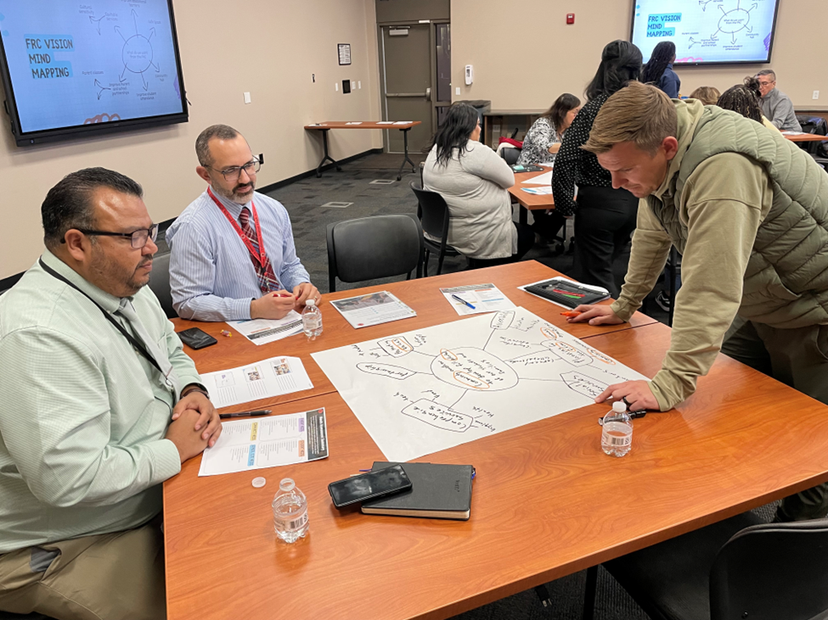
Performance Standards Evaluation process
Principals’ Work Study Meeting
  Reviewed the 30 standards
  Collected evidence for each standard
  Reviewed each standard
School Evaluation Process
  Schools led the process with their staff
  All schools rated each standard
  Data were collected through a spreadsheet
District Evaluation Process
  Reviewed and analyzed schools’ ratings
    Identified areas of improvement and areas of strength
  Synthesized the ratings to determine an overall district rating for each standard
EXCELLENCE IN EVERY ENDEAVOR

Slide 9

Culture of Learning
Standards 1 – 6
Commitment to Learners
  Focus on academic needs
  Attention to non-academic needs
  Emphasizes the importance of continuous learning
  Encourages a supportive learning environment for all
SERVICE Values
  SERVICE values are essential for nurturing a positive culture that encourages growth and development. These values guide interactions and expectations.
EXCELLENCE IN EVERY ENDEAVOR

Slide 10

Leadership for Learning
Standards 7 – 15
Role of Leadership
  Focuses on guiding and mentoring learners
  Promotes leadership development within learning contexts
Importance of Collaboration
  Increase family engagement
  Foster relationships
Professional Development
  Innovative programs for staff
  Opportunity to pursue higher education degrees
EXCELLENCE IN EVERY ENDEAVOR

Slide 11
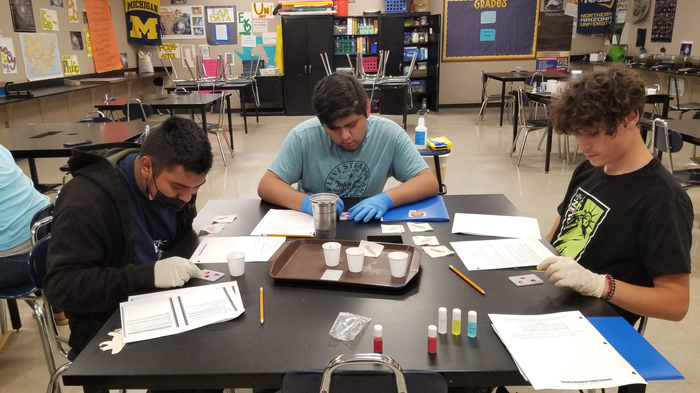
Engagement of Learning
Standards 16-23
Curriculum
  Involves active participation in learning activities
  Enhances motivation and interest in learning
Course Offerings
  Diverse courses available
  Includes Advanced Placement, Career & Technical Education, Dual Enrollment
  Exceptional Student Services and English Language Learner courses
Extracurricular Activities
  Various clubs and activities
  Nita M. Lowey 21st Century Community Learning Center programs
EXCELLENCE IN EVERY ENDEAVOR

Slide 12

TUHSD Curriculum Components
Arizona State Standards
Pacing Guides
Scope & Sequence
Assessments
Materials & Resources
Curriculum outlines what students are expected to learn, how they will be taught, the materials and resources that will be used, and how their learning will be assessed.
EXCELLENCE IN EVERY ENDEAVOR

Slide 13

TUHSD Adopted Curriculum
English Language Arts: Houghton Mifflin Harcourt (HMH), 2022
Math: McGraw Hill, 2023
Social Studies: McGraw Hill, 2022
Science: Saavas, 2023
EXCELLENCE IN EVERY ENDEAVOR

Slide 14

Growth in Learning
Standards 24 -30
Data-Based Decision Making
  Utilization of data from the Education Data & Innovation division
  Involvement of external consulting organizations
  Monitor student progress and development over time
Action Research
  Initial phase of establishing collaborative practices
  Based on research findings
  Encourages setting and achieving learning goals
EXCELLENCE IN EVERY ENDEAVOR

Slide 15
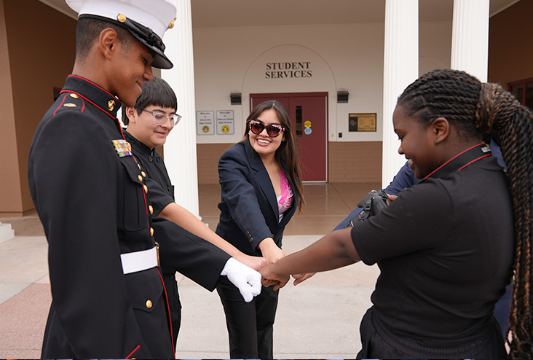
KEY Recommendations
Instructional Model
  Develop and implement an instructional model to include more inquiry and active learning to increase student engagement
Differentiated Learning
  Enhancing differentiated active learning practices to boost student engagement
Assessments
  Evaluate and refine current assessments
  Focus on learning practices
  Monitor and adjust instruction based on data results
EXCELLENCE IN EVERY ENDEAVOR

Slide 16

Celebrate the success!
Commitment to our values
Warm & welcoming climate
Collaboration with WestEd
Degree program
Extracurricular activities
Commitment Day
Collaborative practices
Professional learning opportunities
EXCELLENCE IN EVERY ENDEAVOR

Slide 17

Thank you!
Questions?
EXCELLENCE IN EVERY ENDEAVOR
Notes:
This action was conferred by the Cognia Global Commission on June 26, 2025.

