Slide 1
Fowler Elementary School District #45
Employee Code of Conduct (ECOC) Administrative Guidelines and Regulations
Notes:
NORA:
The 10 members of the Employee Code of Conduct Committee dedicated a great deal of time and energy to coming up with an Employee Code of Conduct. Our committee was comprised of a representative, either administrator or teacher, from each site, including WVCCC and D.O. The purpose of the Employee Code Of Conduct is to outline the minimal expectations of all staff members. The role of a public school employee is one held in high regard by the community, our staff members have elected to work in a public school setting with children and as such, we are held by the public to a hire level of accountability. These expectations are summarized by a list of ten topics which cover all basic expectations, from familiarity and accountability for the enforcement of all district policies, state and federal laws, to honesty, ethics and performing the job to the best of our abilities.
This presentation is a summary of the contents of the employee code of conduct which we will share by reviewing the 10 code of conduct agreement which we will all be held accountable for upholding.
The Employee Code of Conduct was approved by the Governing Board during their June meeting.
The ECOC is intended to assist all staff with understanding the expectations of them as FESD employees. It will assist administrators with implementing staff discipline in a manner which is consistent across the district. Ultimately the goal is to be able to focus all of our efforts on improving instruction for our children.

Slide 2
All Fowler Elementary School District #45 employees shall :
AGREEMENT #1
Employees are expected to comply with established policy, routine, and procedures relating to attendance and punctuality, and adhere to scheduled roles and responsibilities.
Notes:
AGREEMENT 1 Andrew Whitman
Refers to - ATTENDANCE/PUNCUALITY & responsibilities
Be on time ALL OF THE TIME - employees are required to be on time for all district functions including: District in – service days, IEP meetings, District Meetings, Team Meetings, Staff Meetings, etc.
Refer to your principal for clarification on the expectations regarding the Professional Day schedule on your campus.
Sick leave is a benefit provided to us to use when we are ill. Use it as it was intended. Abuse of sick leave negatively affects our students and colleagues.
Fulfill your responsibilities with integrity including:
Accurate record keeping in regards to
Student attendance, Grades, ELD/AZELLA/504/IEP
Do your best to fulfill the responsibilities of students with exceptional needs including
Modifications to your instruction
Accommodations as appropriate

Slide 3
CALENDAR DAYS - According to Policy GCCA the following days will NOT be not be approved as leave days during the 2024-2025 school year
First 10 student days of school, August 1 – August 14
Last 10 student days of school, May 9 – May 22
Any days which extend a long weekend. (Before or after)
Sept. 2, Labor Day
Oct 7 – 11, Fall Break
Nov. 11, Veteran’s Day
Nov. 23 – 29, Thanksgiving Recess
Dec. 23 – Jan 3, Winter Break,
Jan 20, Dr. Martin Luther King Jr., Holiday
Feb. 17, Presidents’ Day
March 10 – 14, Spring Break
April 21, Recess Day
Notes:
Pat Davis, Agreement 1, slide 5
Calendar days

Slide 4
All Fowler Elementary School District #45 employees shall:
#2 Be truthful and honest regarding all matters of interest to the Fowler Elementary School District.
Notes:
Pat Davis,
Agreement 2

Slide 5
All Fowler Elementary School District #45 employees shall:
#3. Promote a safe and healthy environment and conduct themselves in a manner free from harassment, intimidation, bullying, substance abuse, bias discrimination and violence.
Notes:
Alyce Layden
Agreement 3
The joker - Don’t tell jokes either in class or in the staff lounge that contain references to race, gender or sexuality. Don’t share something that has the potential to offend. Don’t tease and don’t tell inappropriate jokes or jokingly harass your colleagues.
Remember that all items which you generate are included in this agreement - emails, text messages and personal web pages.

Slide 6
All Fowler Elementary School District #45 employees shall:
#4 Comply with justifiable directives issued by a recognized source of authority.
Notes:
Ruben Palomares
Agreement #4 involves supervisors, supervision and defining reasonable directives.
Regardless of our position we all have a supervisor who is ultimately responsible for ensuring that the job is done well.
What is the definition of a justifiable directive?
Teachers:
Scenario A. Your administrator directs you to modify your lesson plans for a student in your class who has an IEP. Despite the fact that this may involve additional time from the teacher, it is a reasonable directive. The child is entitled to an appropriate education.
Scenario B. Your Assistant Principal directs you to cover a duty which does not fall on your normally scheduled duty day. This is a reasonable directive motivated by ensuring the safety of our students.
Both of the above are reasonable directives given by a recognized source of authority.
It is the expectation that we will ALL Speak to colleagues, students, supervisors and parents in a manner which is courteous, professional and respectful. If it is not nice, don’t say it.
Don’t say it to be funny and don’t say it to be hurtful. “If you can’t say something nice, than don’t say anything.”

Slide 7
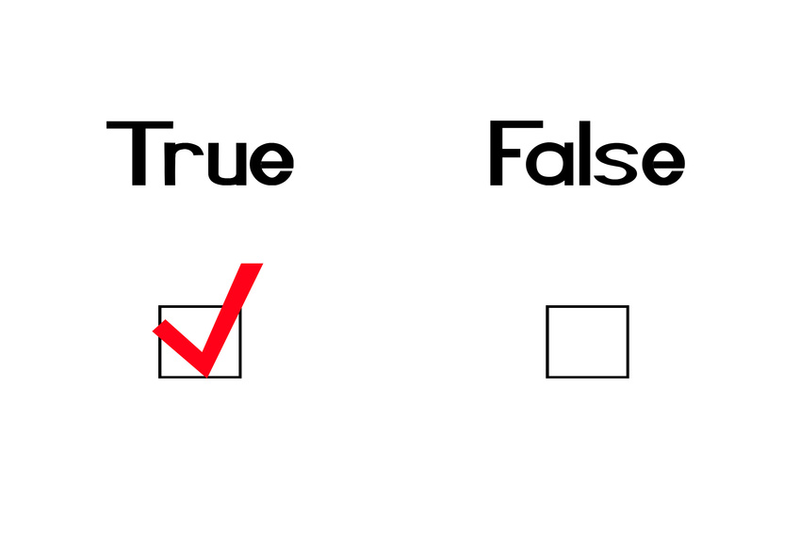
All Fowler Elementary School District #45 employees shall:
#5 Be truthful and properly present and use documents, data and other information sources of interest to the Fowler Elementary School District.
Notes:
RUBEN Palomares Agreement 5
Examples:
Always be honest when filling out any required documentation. Often it is tempting to fudge, or tell a “white lie.” A job applicant who chooses not to disclose a DUI because it occurred 10 years ago, will lose the job as soon as the background check catches up with him. An error of omission is dishonesty.
Answer questions truthfully and honestly in every way in which it is relevant in the performance of your daily responsibilities.
Sometimes falsification is tempting - For example, you may be tempted into giving kids higher grades than they deserve because the parent wants the child on honor roll. It might be easier to give the higher grade than to explain to the parent why the child didn’t get the grade. This behavior would be unprofessional and unethical.

Slide 8
All Fowler Elementary School District #45 employees shall:
#6 Conduct themselves in a manner, on or off Fowler Elementary School District property or outside the established contract day, that does not affect the ability of the employee to perform his her job duties
Notes:
Alex Mora, Agreement 6
Agreement 6 involves employee conduct
Examples:
Drinking in a restaurant or bar when parents and students are present. Monitor your behavior both on campus and off campus.
Having a relationship with a subordinate (because it interferes with your ability to do your job).
Having a relationship with a parent of a student in your class.
Putting pictures or comments on your personal social networking page which are unprofessional, such as pictures of you celebrating and drinking with fellow staff members, pictures of you in your sleepwear or swimwear, romantic pictures of you and spouse, inappropriate comments, such as…. which insult your team members.
The bottom line is that if others can see it - it is public.

Slide 9
All Fowler Elementary School District #45 employees shall:
#7 Maintain confidentiality in all manners pertinent to the Fowler Elementary School District including but not limited to local, state and federal policies.
Notes:
Alex Mora, AGREEMENT 7
Overview:
Just as you are the guardian of students, you are the guardian of their personal and academic information.
Examples of violations include:
Do not share educational data with someone who is not a parent or teacher, or someone who otherwise does not have a need for the information. ex. IEP, 504, student grades - This is verly likely to happen in the context of a conversation which takes place in a staff lounge or at lunch at a local restaurant, be mindful of the need to maintain confidentiality
Avoid Unauthorized removal of sensitive data, There is a reason why the secretary gets mad when you walk out of the vault with a student file, without informing her. The school is responsible for those records and they are confidential.
Never allow unauthorized users to gain access to secure information (Giving students your logon password/code or leaving your log-in information in a visible spot next to your computer.
Never leaving confidential information unsecured (Testing booklets)
Do not in any way compromise school documentation, payroll, personnel, or student health records

Slide 10
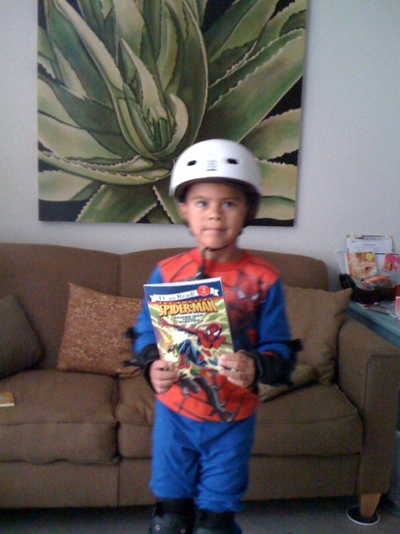
All Fowler Elementary School District #45 employees shall:
#8 Plan, prepare and provide for optimal execution of job responsibilities.
Notes:
Cliff McGonigle Agreement 8
Involves appropriate preparation for your assigned duties, although it sometimes feel like we need to be a superhero wearing protective gear, more often it is simply a matter of preparing for the day :
A. Administrators must look the part of the professional in order to execute the job with the full vote of confidence of parents, staff members, students and the community.
B. Office secretary - don’t wear stiletto heels, you may injure yourself, and you may not be able to help children or parents & you are setting yourself up for an injury.
Teachers - Failure to plan for instruction, failure to prepare for accurate instruction during an absence, failure to report to playground duty in a timely manner.
Maintenance Worker – should dress for the weather and the tasks, and should consider safety including having plenty of water, when preparing f the day.

Slide 11
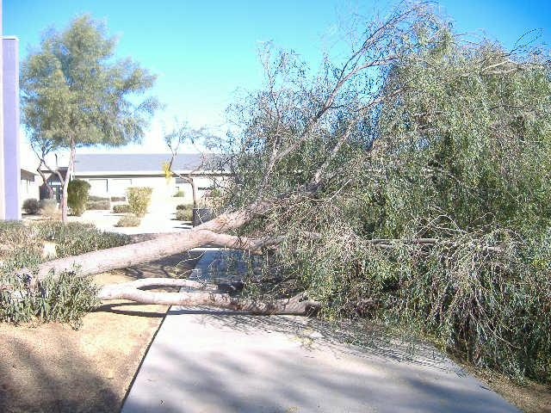
All Fowler Elementary School District #45 employees shall:
#9 Immediately intervene and report any code of conduct violation that negatively impacts an environment conducive to safe and supportive learning
Notes:
Cliff McGonigle Agreement 9
a. Not being a bystander
1. Comparable to a bully bystander
b. Gossiping
c. Organized classroom environment
d. Be professionally responsible for your noise volume
1. Both in and out of the classroom
e. Do not make a decision based on rumors or information that has not been substantiated
If no one stands up for what is right then the behavior is condoned and viewed as acceptable by the individual.

Slide 12
All Fowler Elementary School District #45 employees shall:
#10 Comply with all Fowler Elementary School District, local, state and federal policies.
If it is in FESD policy, local, state or federal law it is covered by our Employee Code of Conduct.
Notes:
Cliff McGonigle Agreement 10
Each FESD employee is responsible for everything which is not explicitly stated in the ECOC which falls under local, state or federal law.
You MUST teach to the standards even if you don’t agree with them.
Examples:
You can’t bring weapons to school
You cannot pack an alcoholic beverage in your lunch
Buy illegal drugs on your day off
Borrow school property without permission
“Harmless” examples:
Call in sick when you are NOT sick
Use a district vehicle for personal trips

Slide 13
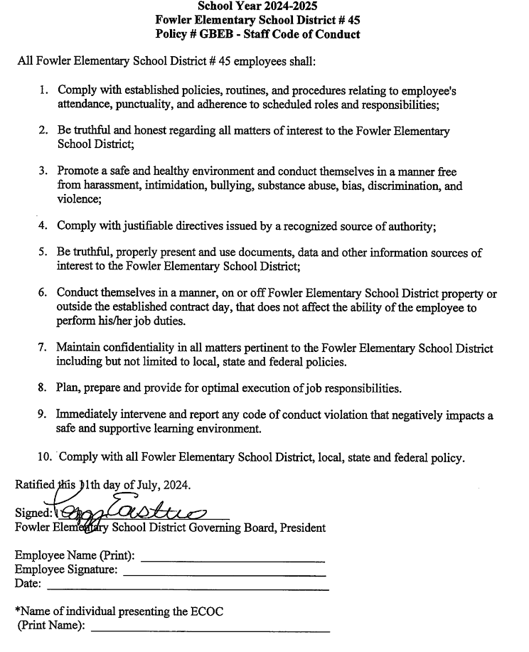
All FESD employees will need to sign the ECOC annually.
Thank You!
Notes:
Cliff McGonigle Agreement 10
Each FESD employee is responsible for everything which is not explicitly stated in the ECOC which falls under local, state or federal law.
You MUST teach to the standards even if you don’t agree with them.
Examples:
You can’t bring weapons to school
You cannot pack an alcoholic beverage in your lunch
Buy illegal drugs on your day off
Borrow school property without permission
“Harmless” examples:
Call in sick when you are NOT sick
Use a district vehicle for personal trips

