Slide 1



December 9, 2025
7:00 PM Rimrock Library

Slide 2



Rimrock Principal Report

Slide 3
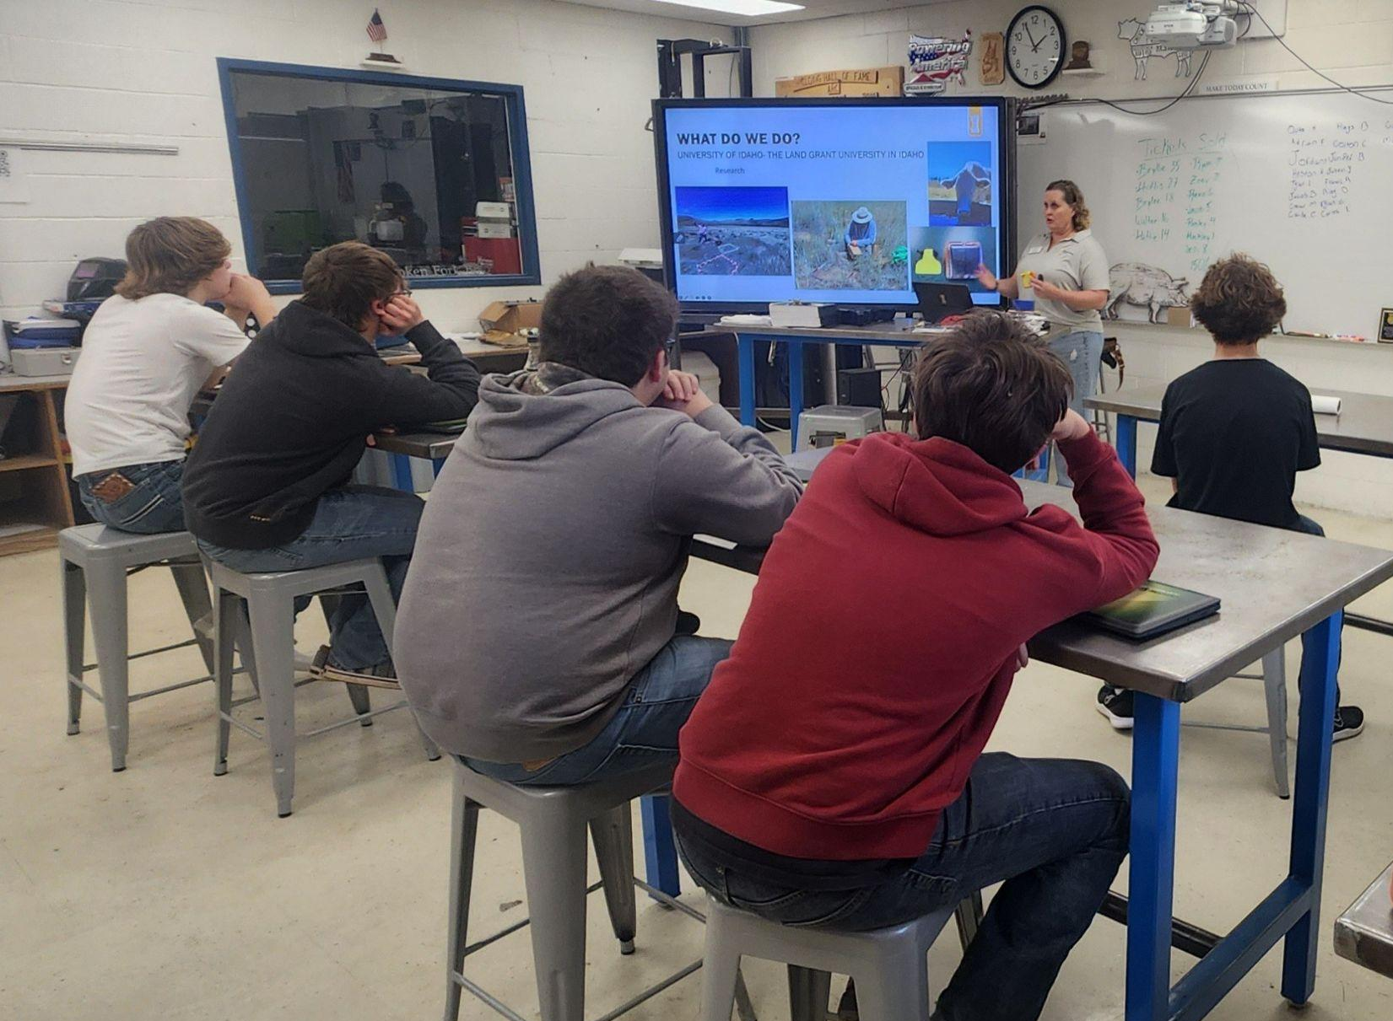
Rimrock Academics
Rimrock Vision: To be the best small, rural, public Jr-Sr High School in Idaho…
a place our students, staff, graduates and community can be proud of!
Semester ends 18 Dec 2025
  Grades finalized by 6 Jan 2025
  15 students currently at-risk for losing one or more credits due to attendance . . . 6 Jan 25 petition deadline
Mid-Year MAP Testing underway (most finish this week, makeups next week)
  Results will be shared in January
  Overall Goal: Median Growth Score in 60th Percentile for every grade / subject)
College & Career Readiness:
  Idaho Launch: Rimrock = 100% (State = 26%)
  Apply Idaho: Rimrock = 100% (State = 49%)
  PSAT: Rimrock’s average scores exceeded national average
    10th graders(14 students) averaged 975; (+85 over national average 890)
    11th graders (8 students) averaged 1085; (+105 over national average 980)
IOT Update:
  12 Students will complete Career Exploration and Employment Preparation class this semester (prerequisite)
  1 student began EMT course in November as a Work-Based Learning Experience (for academic credit)
  8 students to take Career Exploration and Employment Prep next semester / 4 planning to do Work-Based Learning

Slide 4
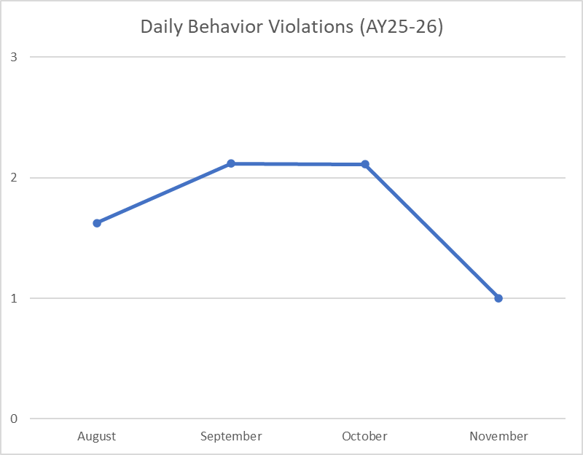
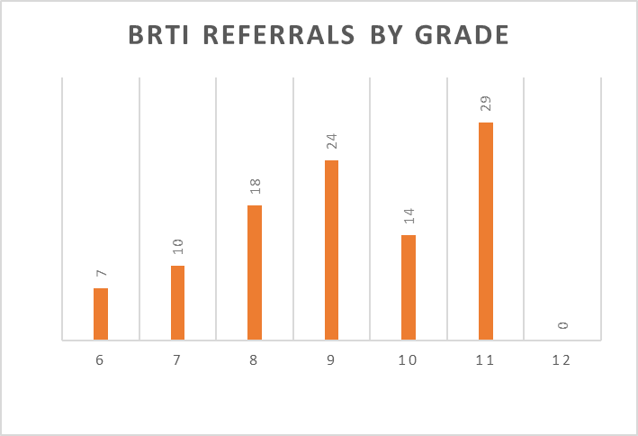
Rimrock Behavior
Sources of Strength Guest Speaker on 19 Nov 25, presented on “Gratitude”
Behavior Response to Intervention Referrals:
  Goal that BRtI Violations stabilize at ≤ 1 / day by October 2025 (met target in November at 1/day, see below)
  BRtI 3rd Violation by 15/123 students (12%)... goal is ≤ 5%
  BRtI 4+ Violations by 7 students (6%)… goal is ≤ 2%
  Trend: Less total violations than last year, but small subset of students incurring behavior referrals with increased frequency compared to past
  Top 3 Referrals (by frequency):
Disruptive Behavior in Class
Insubordination / Disrespect
Academic Integrity
Target ≤ 1/day

Slide 5
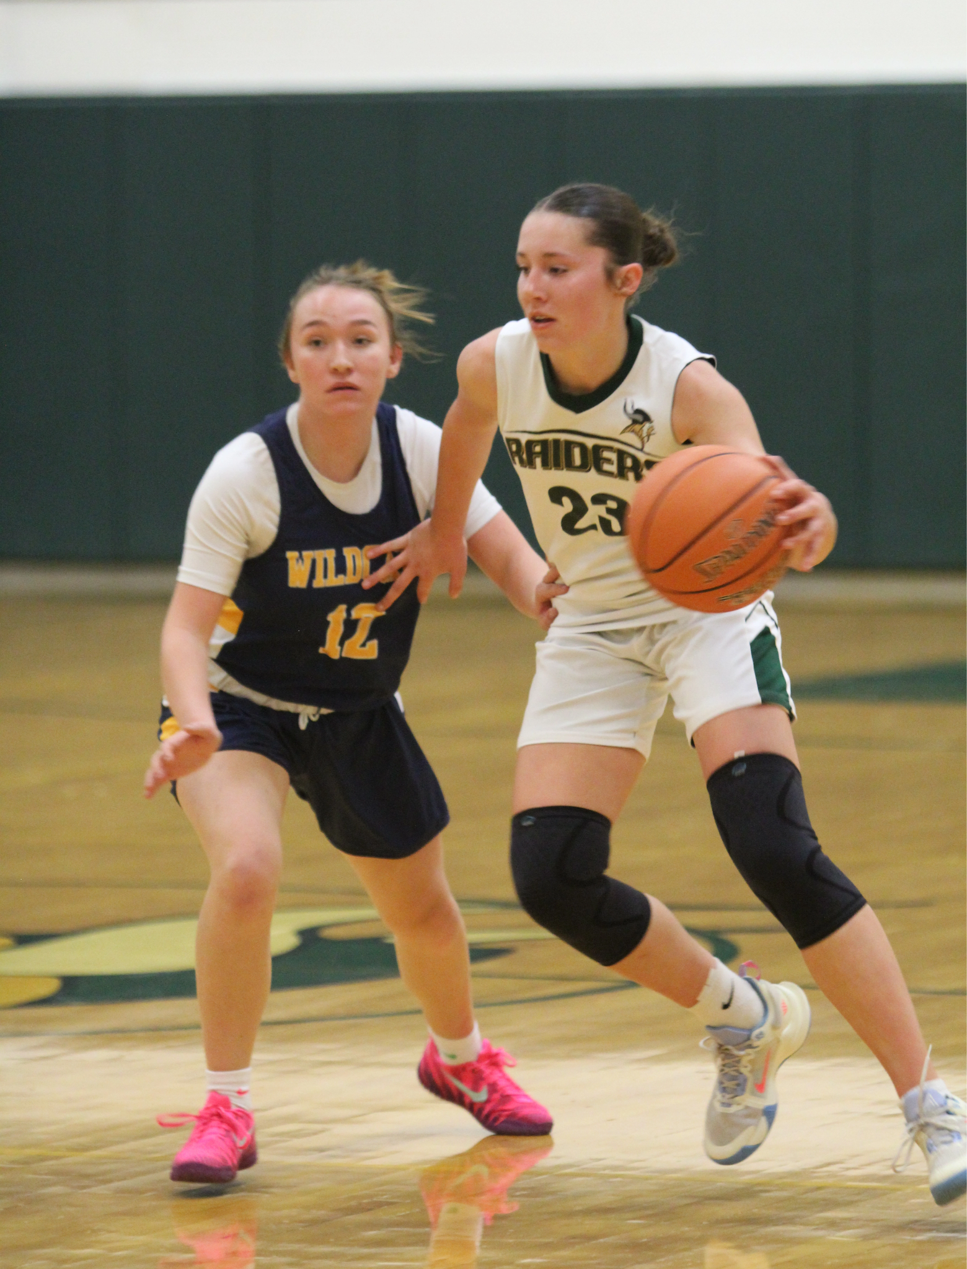

Rimrock Culture
Current Enrollment: 123 (net change = -3 . . . all students moving out of the local area)
Average Daily Attendance: 94% (CAO 1 Dec 25) . . . Goal: 95%; Dec 24 = 94%
Athletics:
JH Girls Basketball: Season Complete (8-1), lost in Conference semifinals
HS Girls Basketball: 12 girls (Varsity/JV) . . . Varsity: 2 - 5
HS Boys Basketball: 18 boys (Varsity/JV) . . . Varsity: 2 - 0
FFA:
Article in most recent issue of “The Cattle Mag” highlighting Rimrock FFA chapters collection of ~2700 lbs of food donations at Cowboy Christmas
3 Dec: Boise Valley FFA District Ag Mech Event
  Rimrock sent 3 competitors
  Tyler Lisle earned 1st place in Tool ID
Employee Recognition: Stephanie Danner
3rd year in District / 2nd year teacher of both JH Math and Social Studies
Completed teaching certificate through District’s para-to-teacher program
Volunteered to be JH Girls Basketball coach, led team to District semifinals!
Actively working with HS Math teacher to prepare math curriculum review

Slide 6
Elementary Principal Report

Slide 7

Growth from August 20 to November 10
Most Ind. Growth
Kindergarten | 78%
1st Grade | 88%
2nd Grade | 95%
3rd Grade | 85%
4th Grade | 81%
5th Grade | 77%
Total Growth | 83%
+44
+83
+44
+34
+47
+36

Slide 8
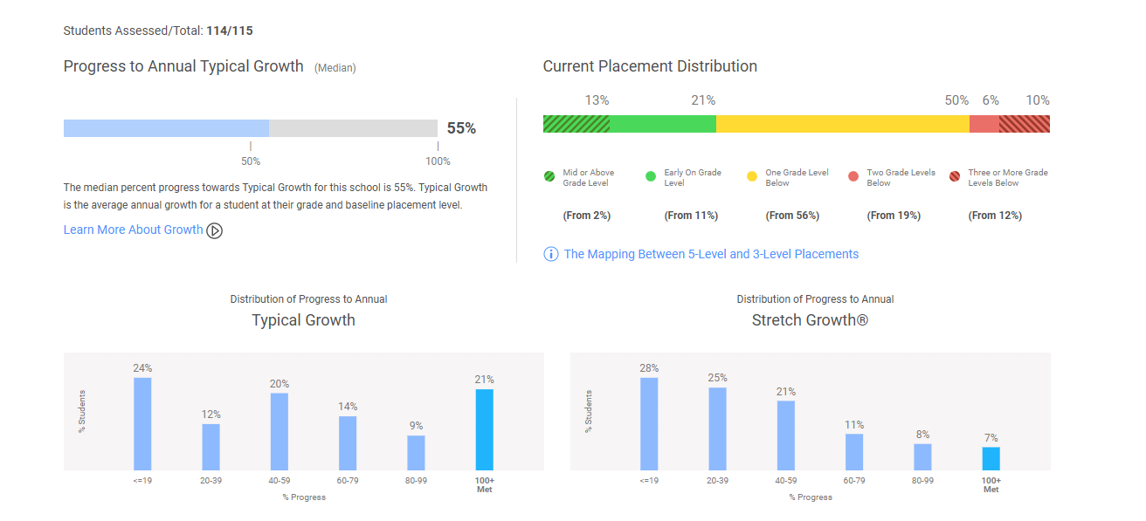

Slide 10

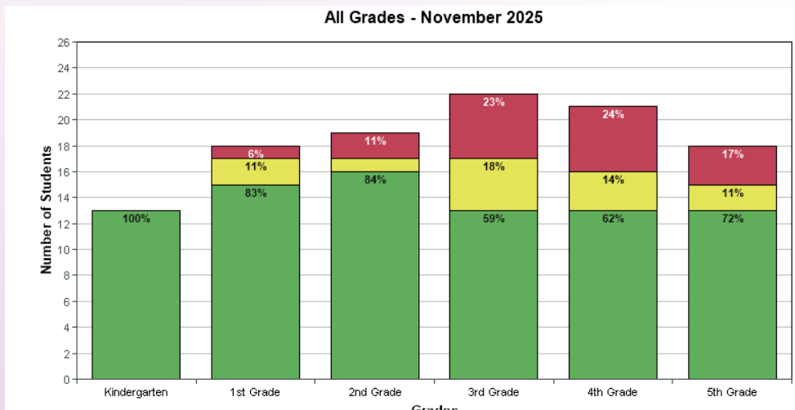

Slide 11
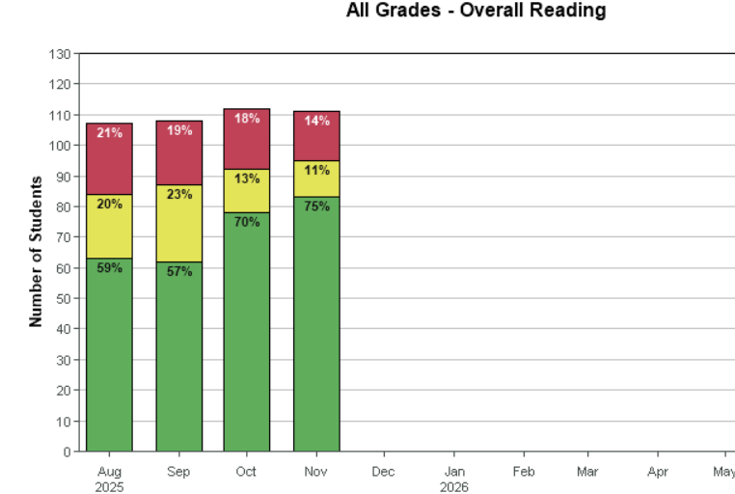

Slide 12
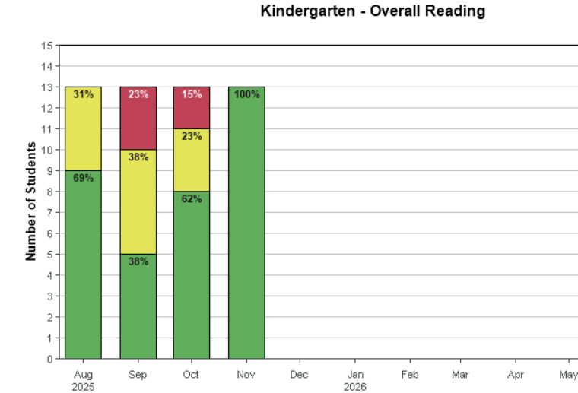

Slide 13
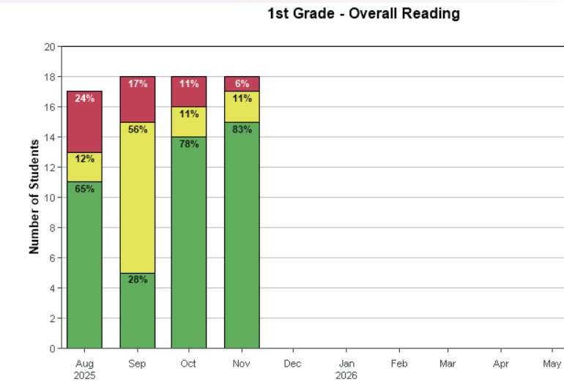

Slide 14
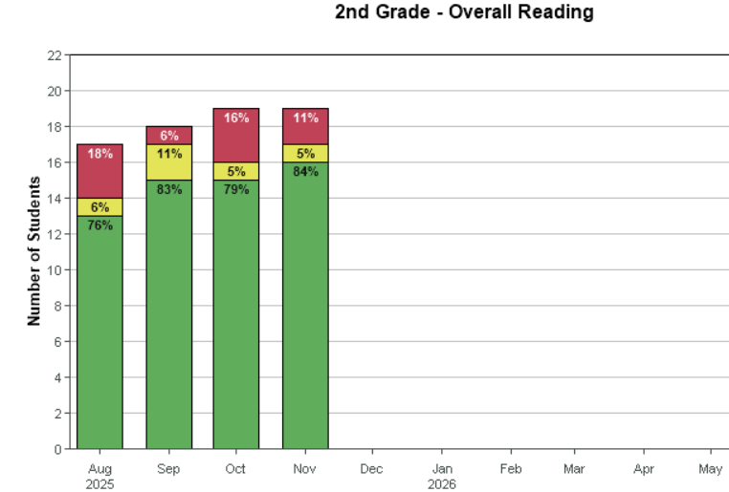

Slide 15
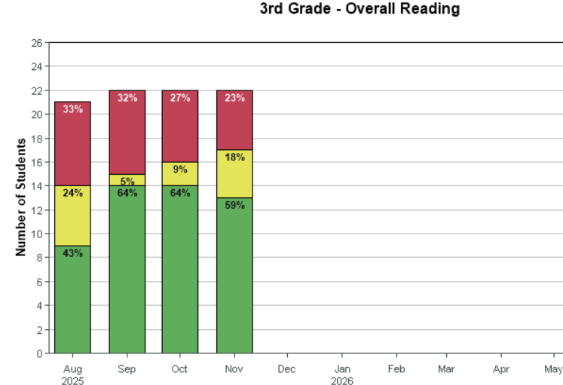

Slide 16
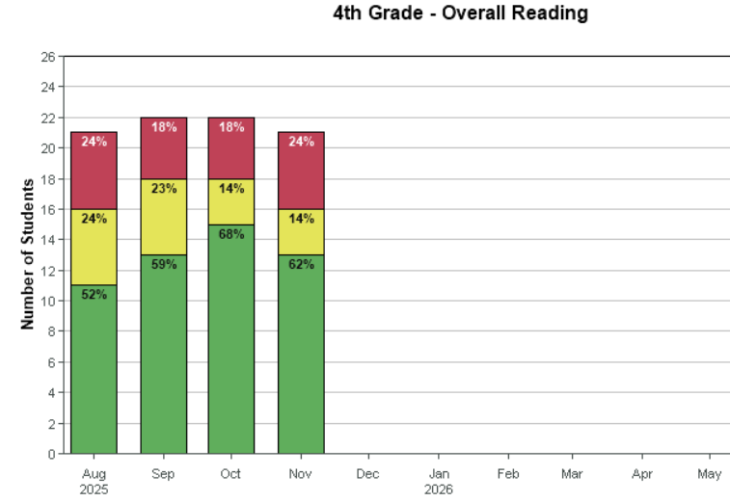

Slide 17
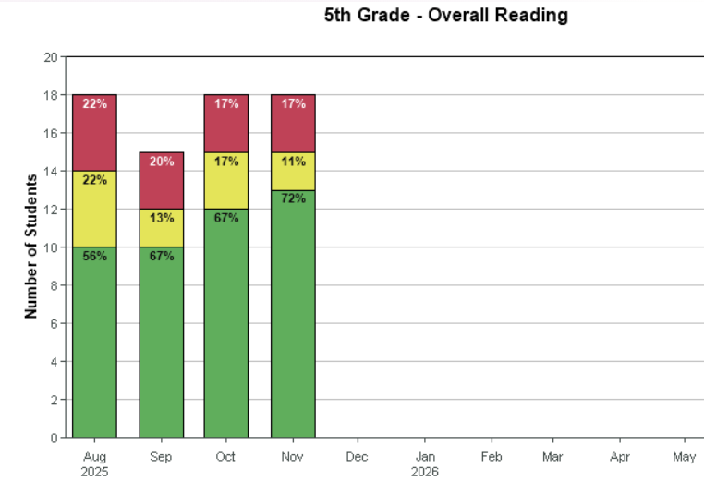

Slide 18
Upcoming Elementary Events
12/17: Winter Music Concert - Treats and Tunes
- Starts promptly at 6 in the Rimrock Auditorium
12/18: Last Day before Break
01/05: First Day back from Break
01/08: Report Cards sent home

Slide 19
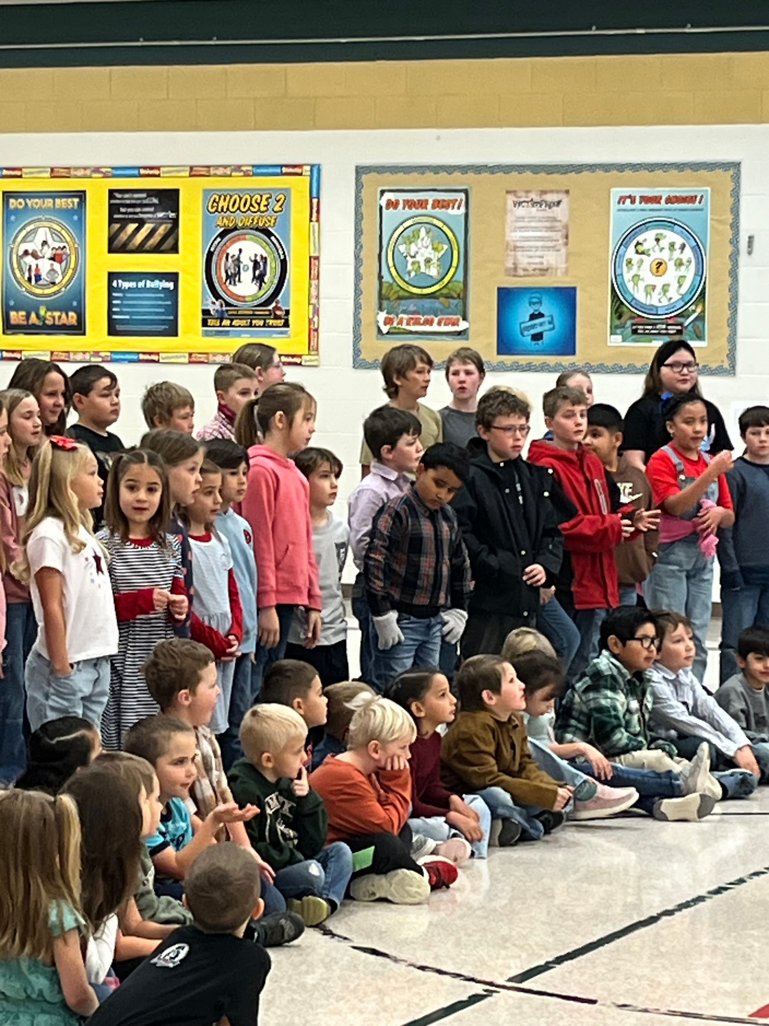
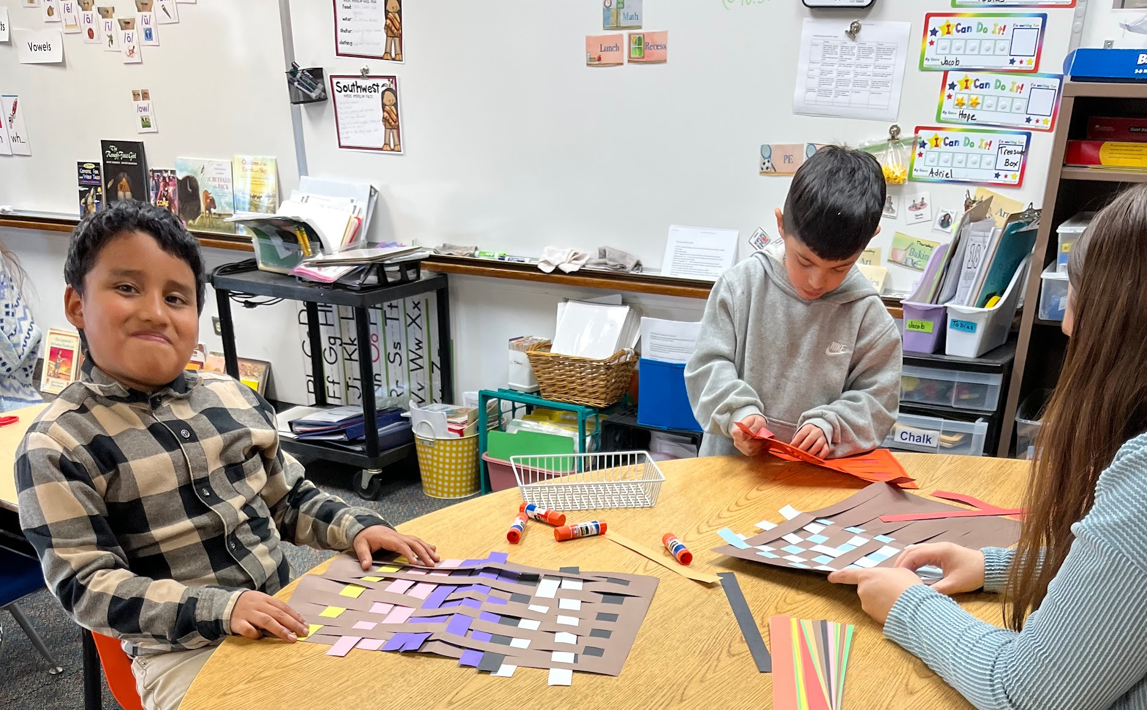
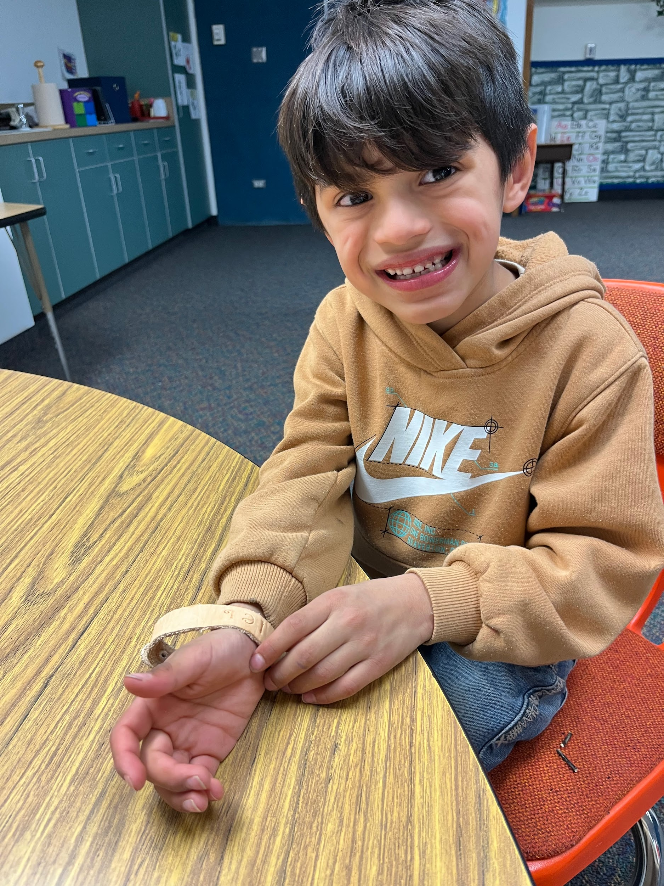
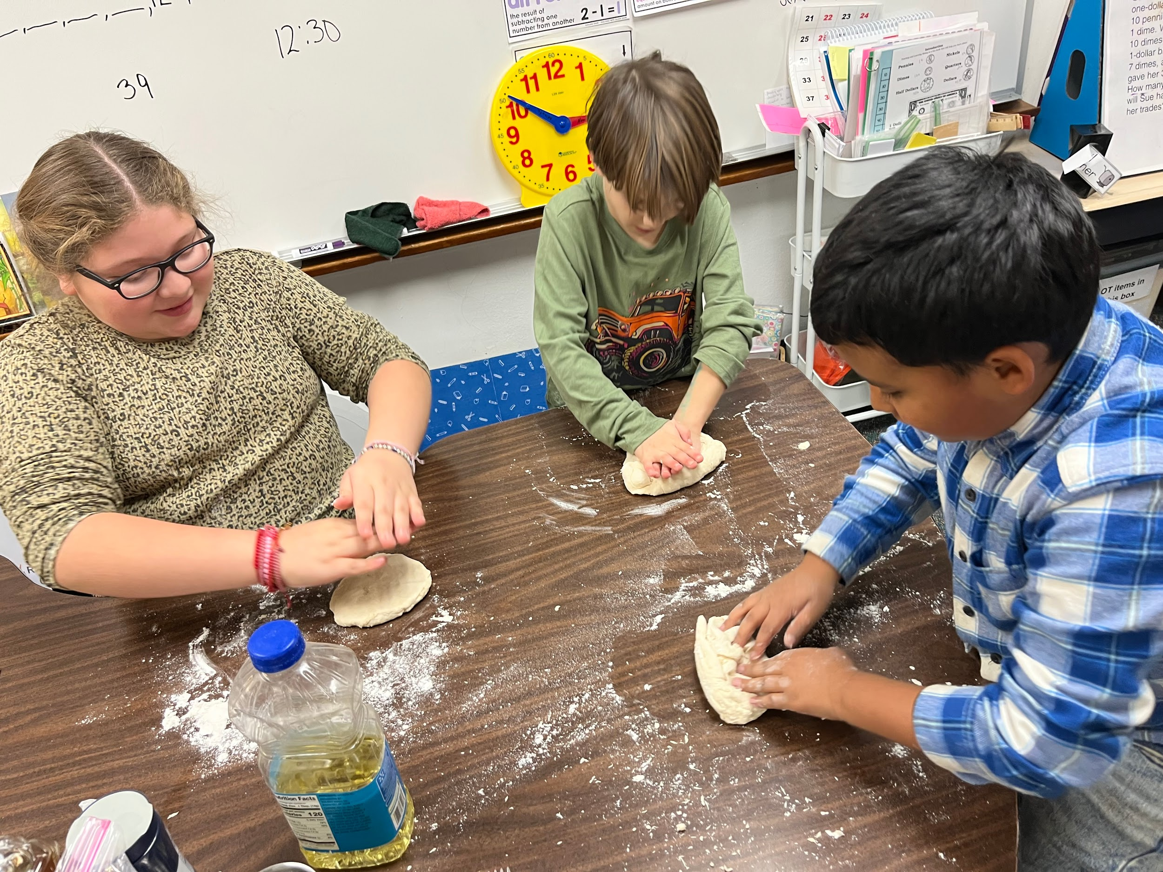
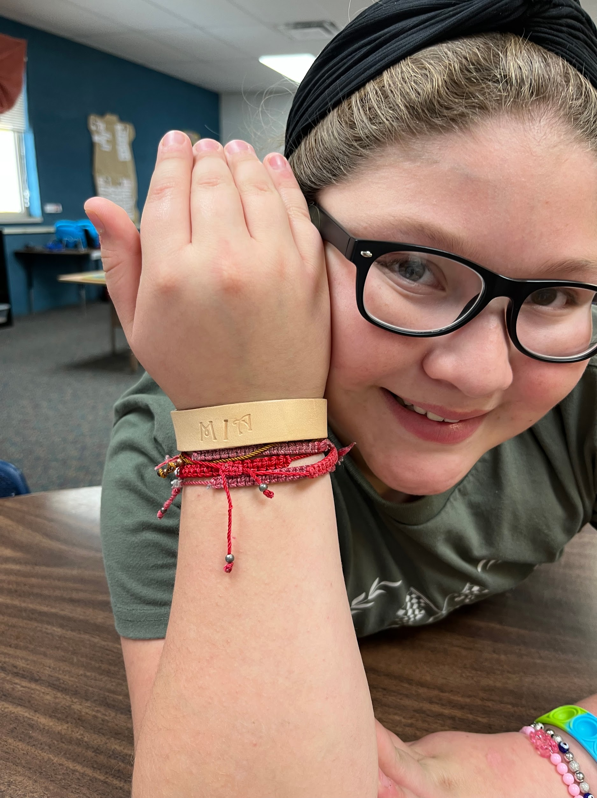
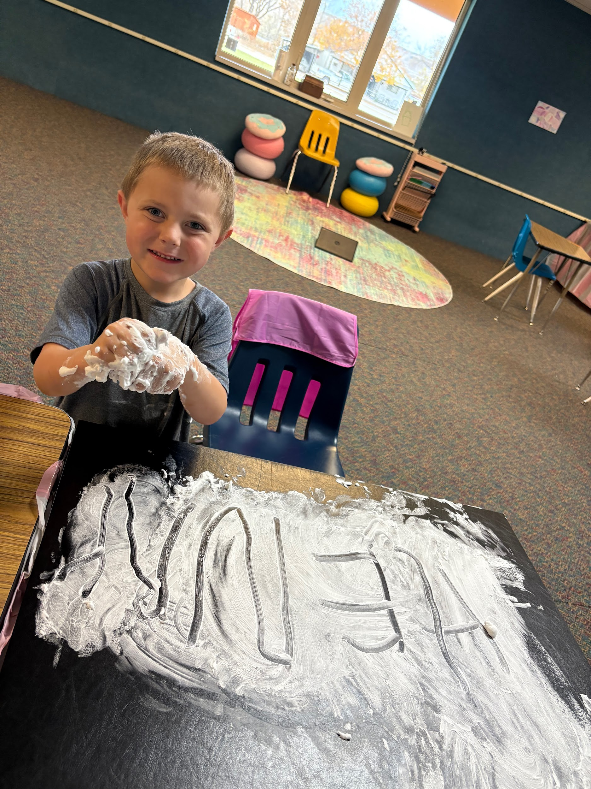

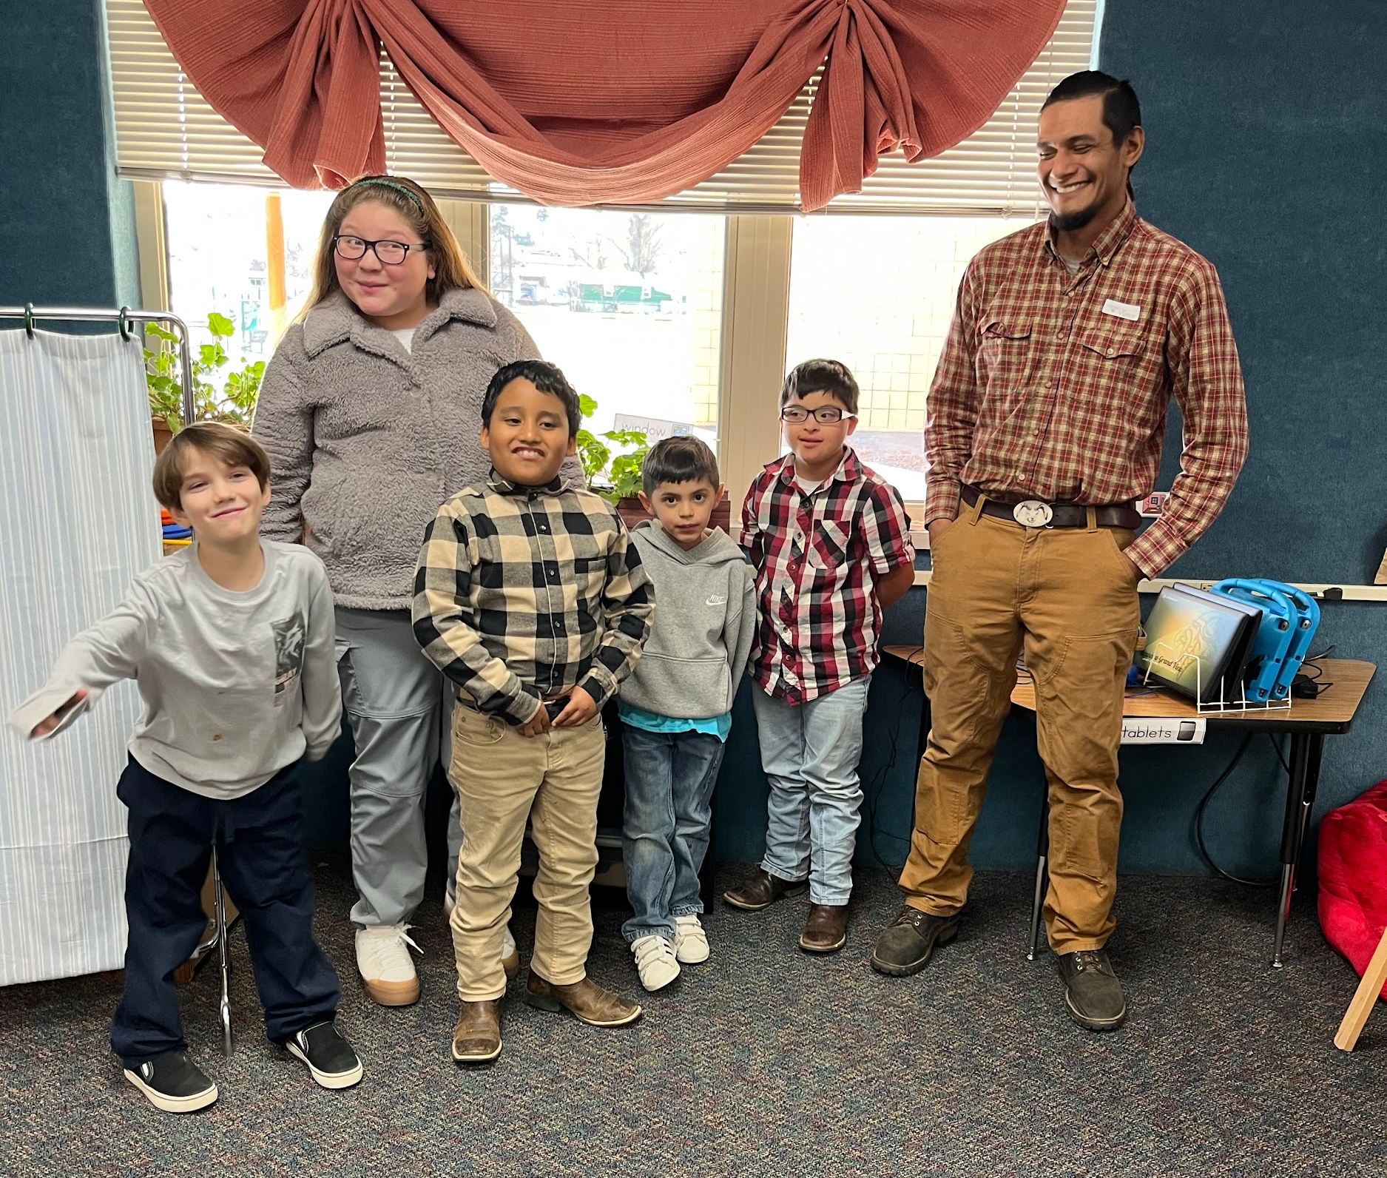
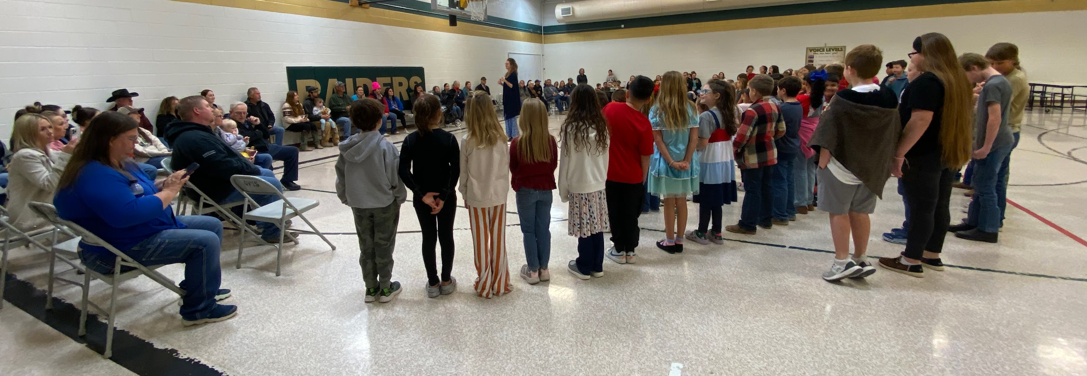
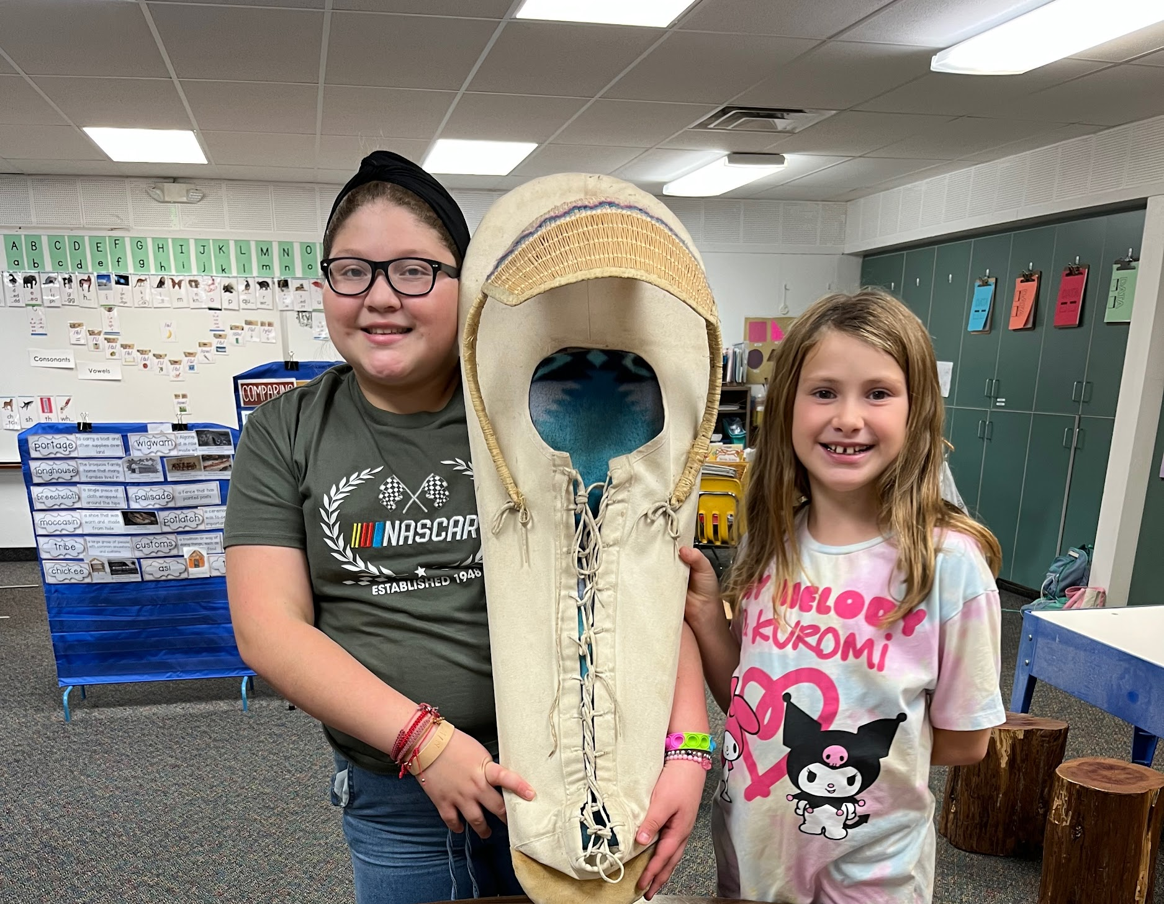
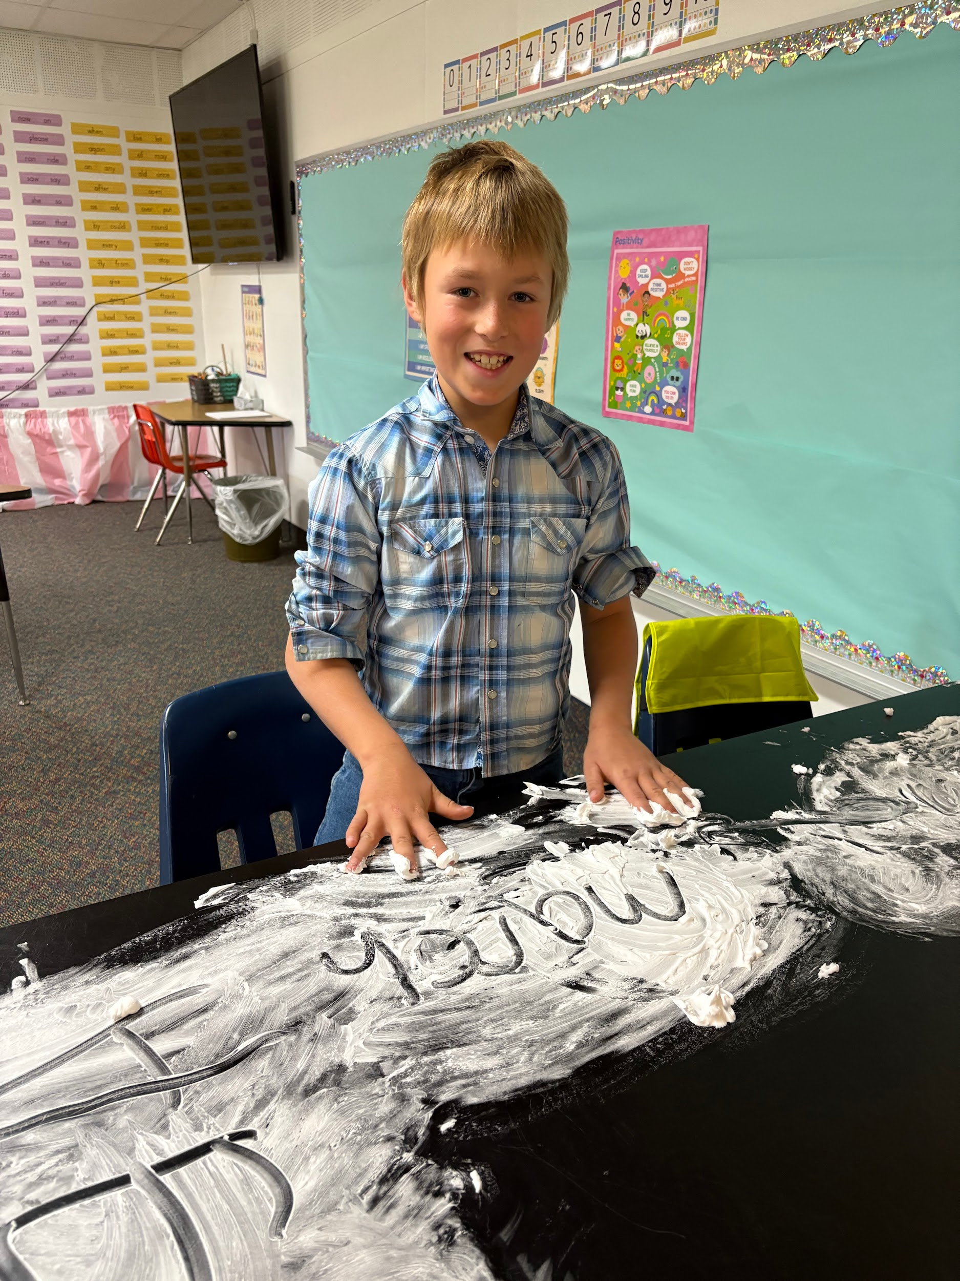
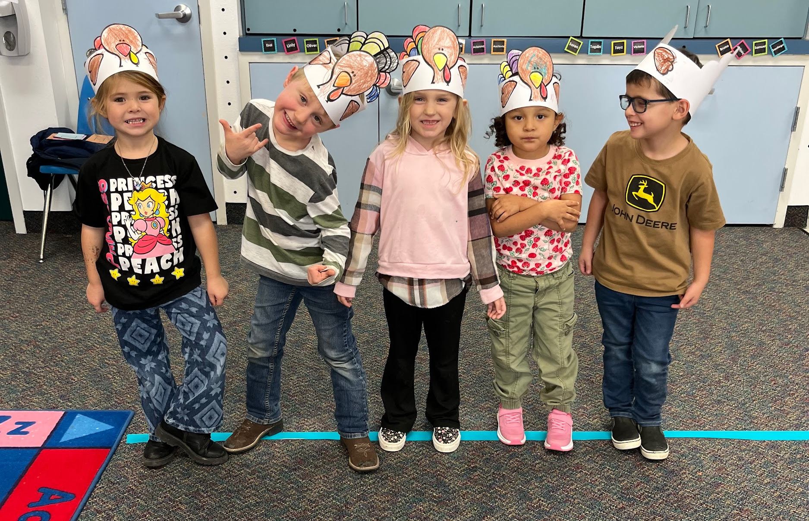
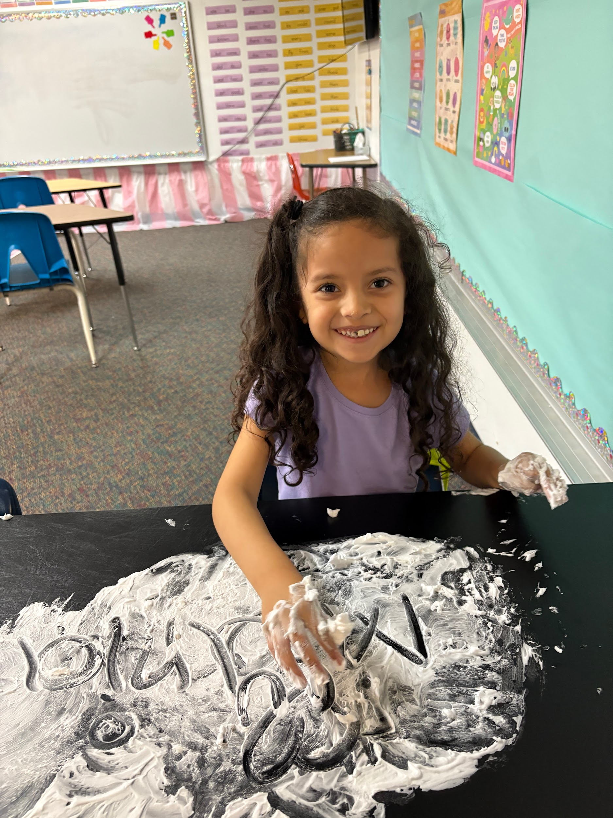
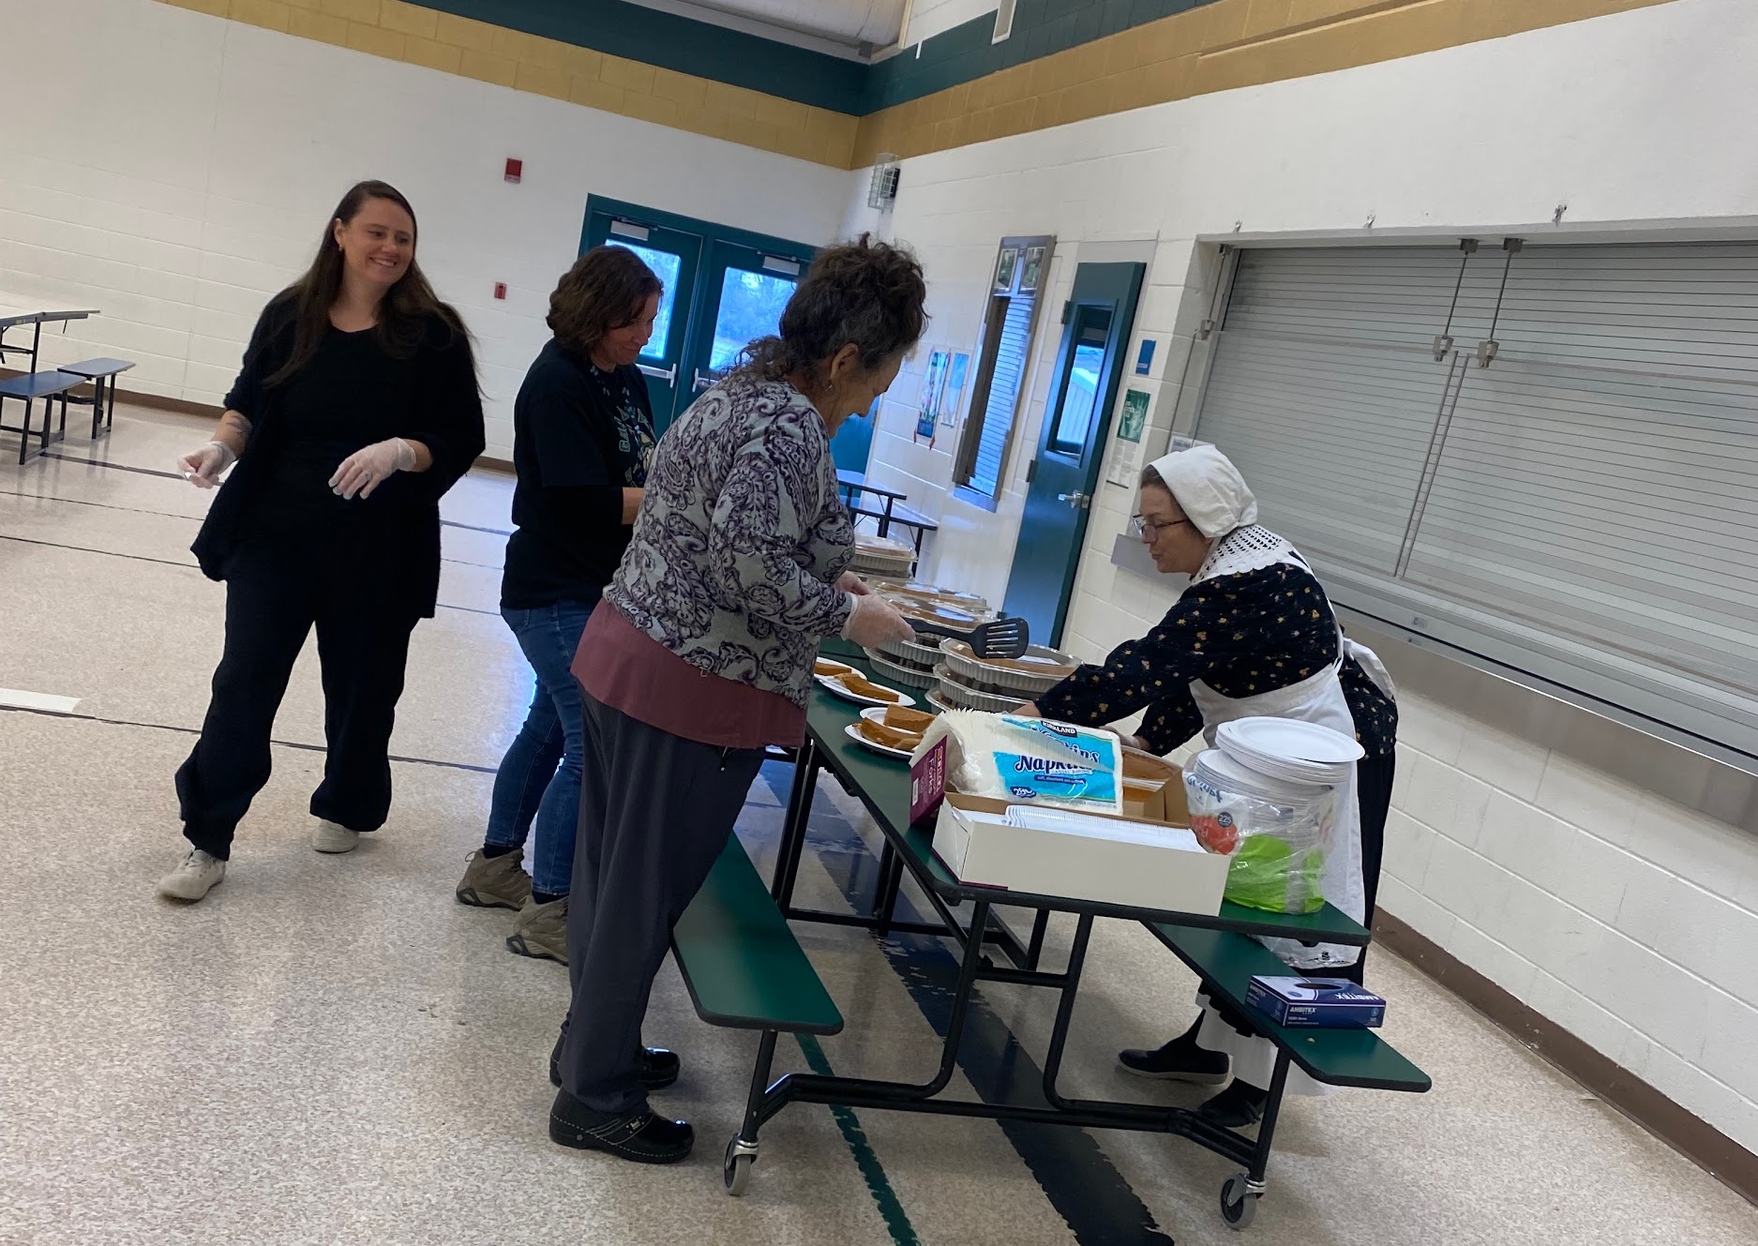
GVE

Slide 20
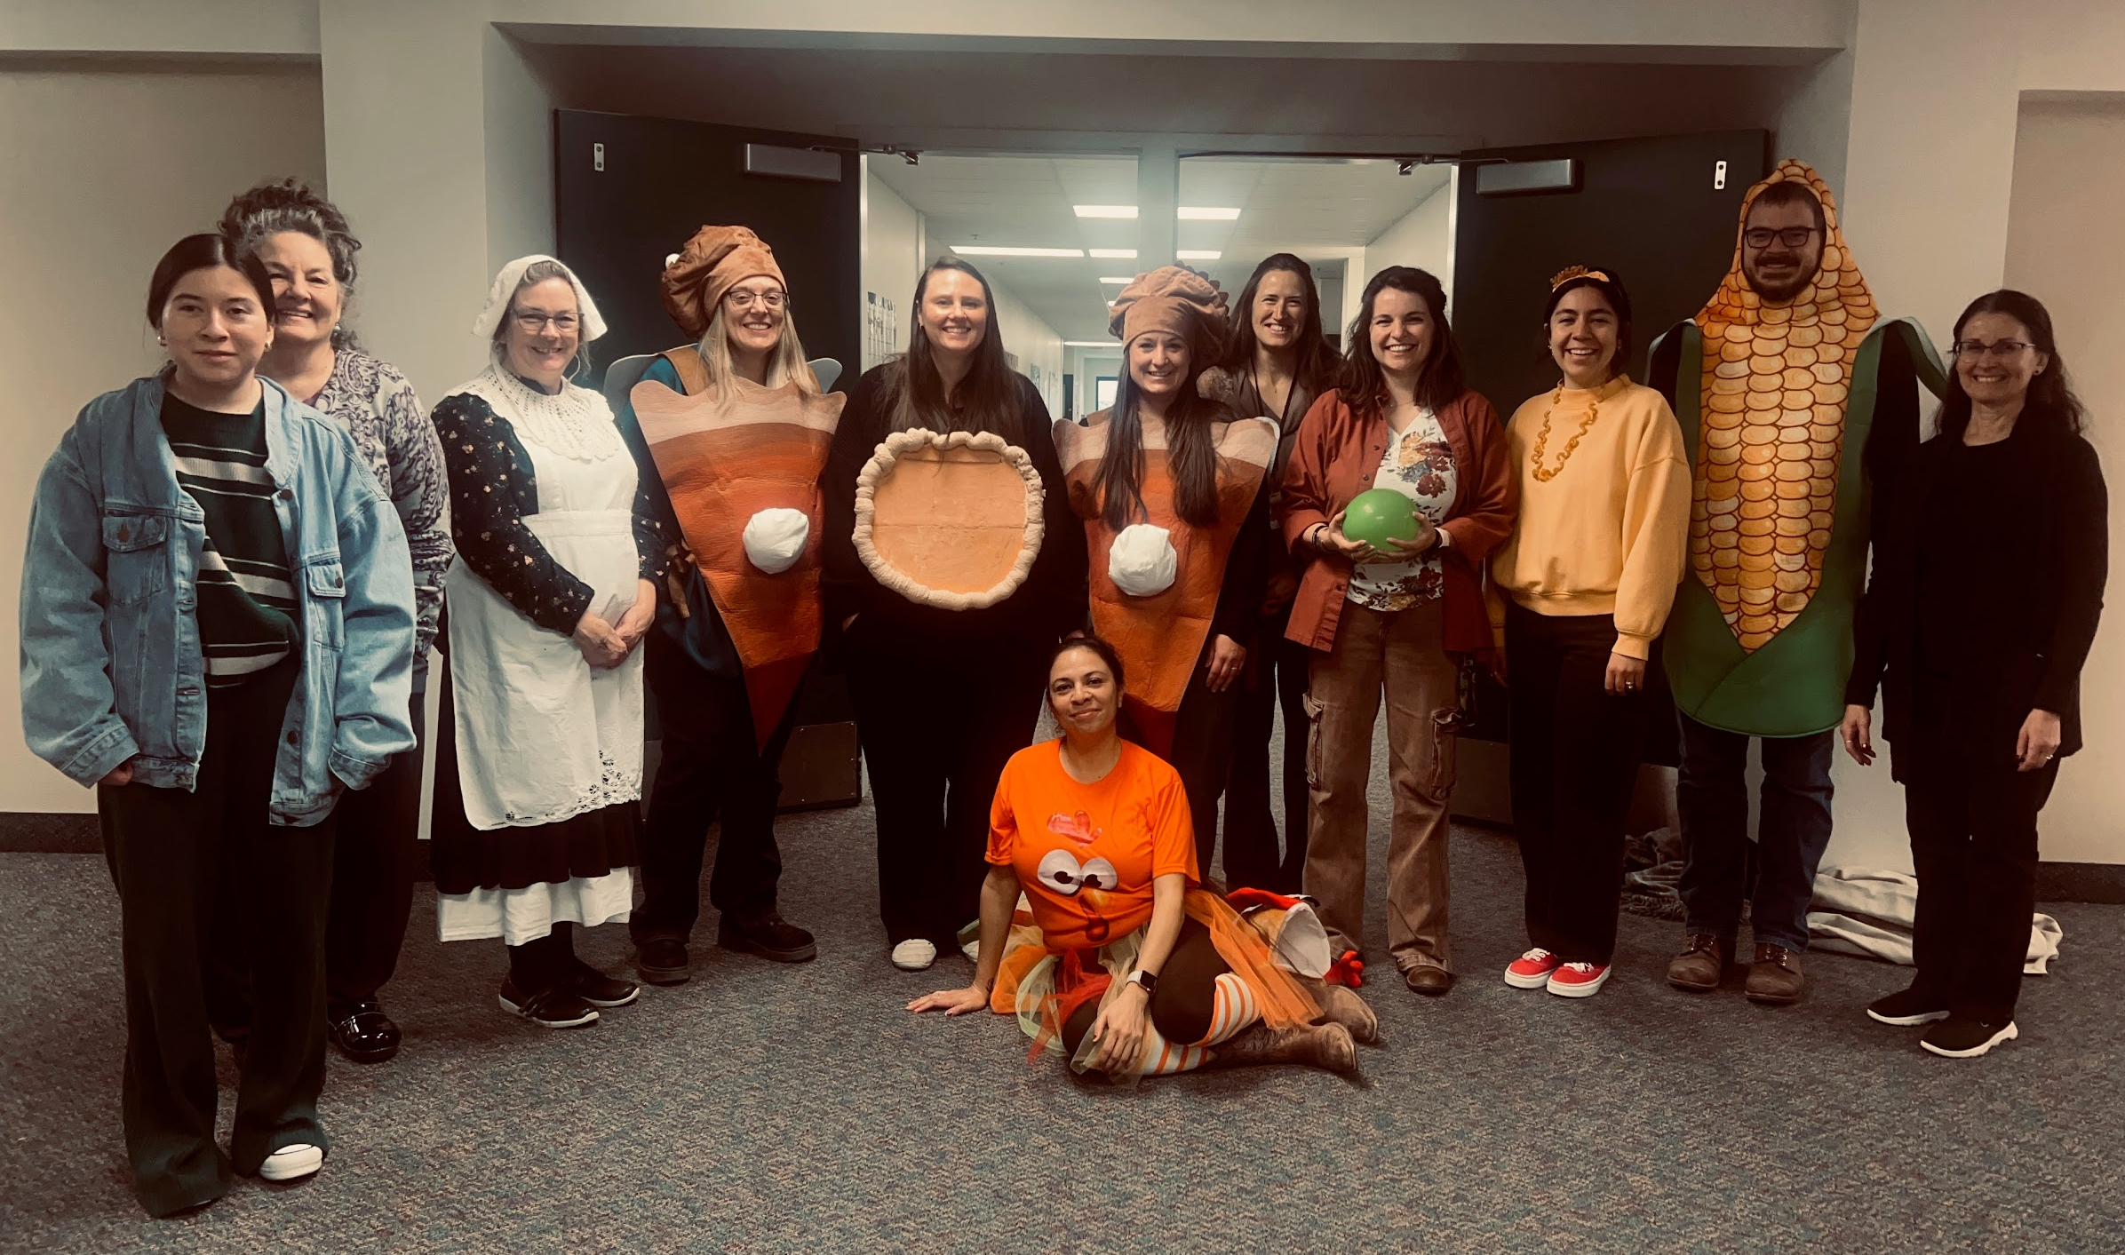
GVE Staff Spotlight

Slide 21
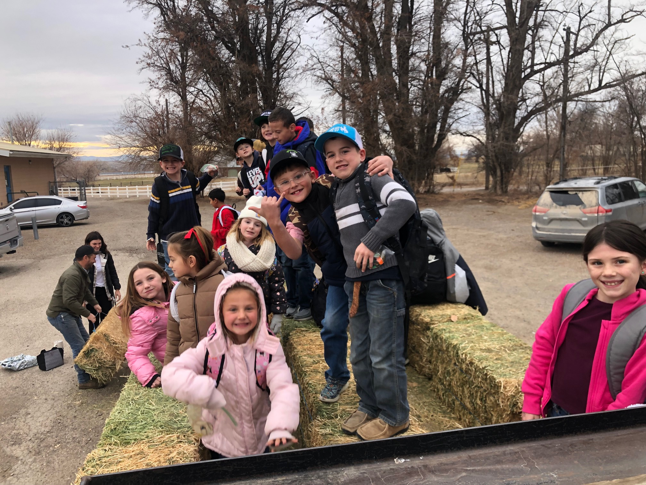
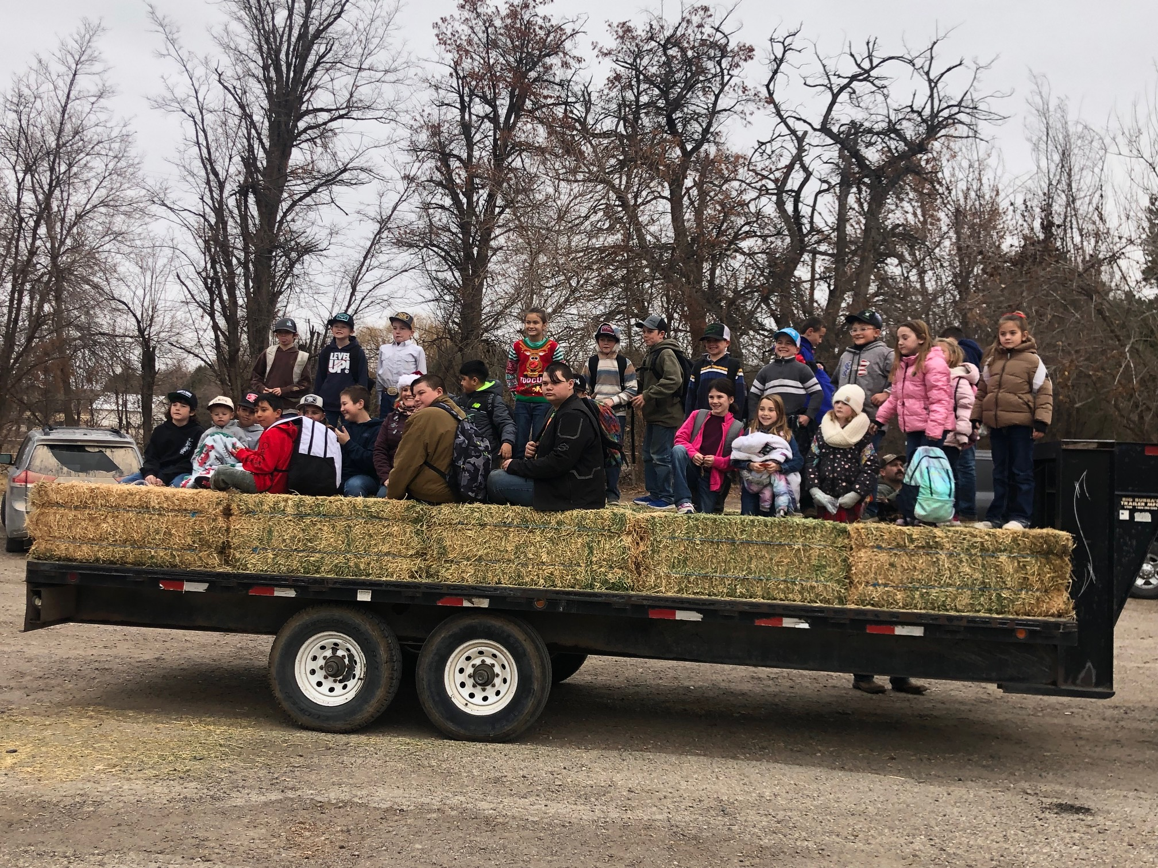
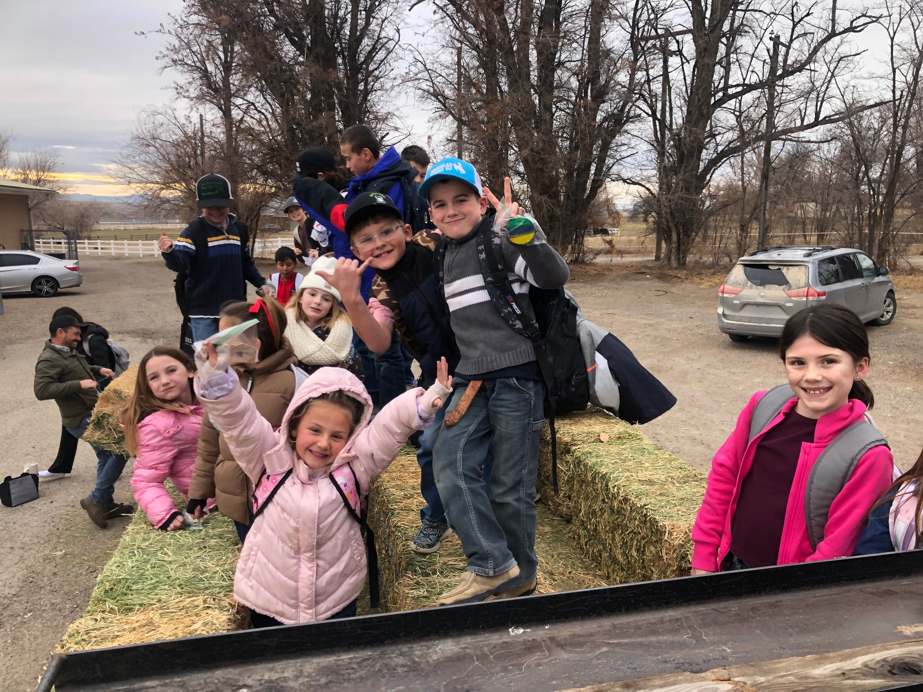
BES - Hay ride to the Bruneau Park (Mr. Bachman)
Annual Christmas Tree Lighting

Slide 22
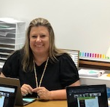
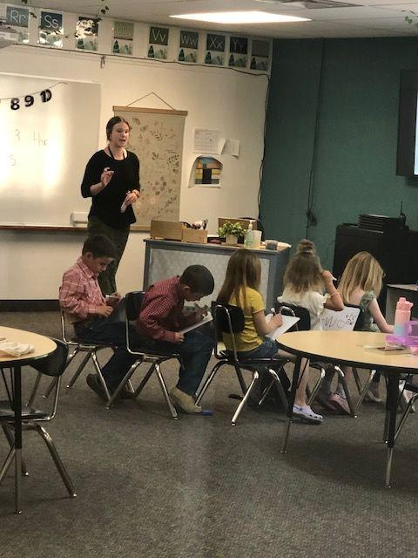
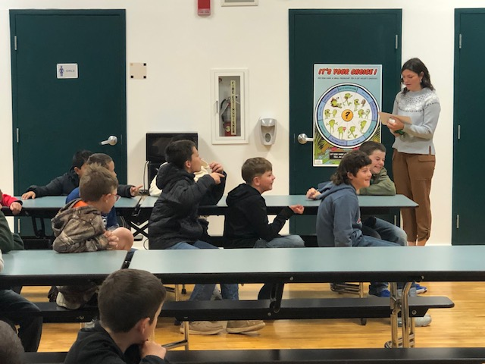
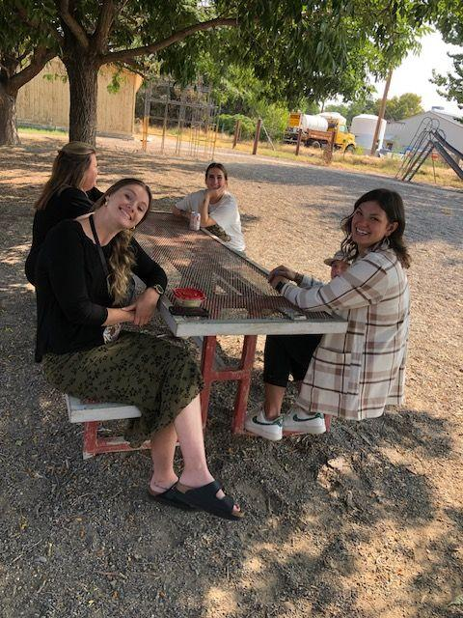
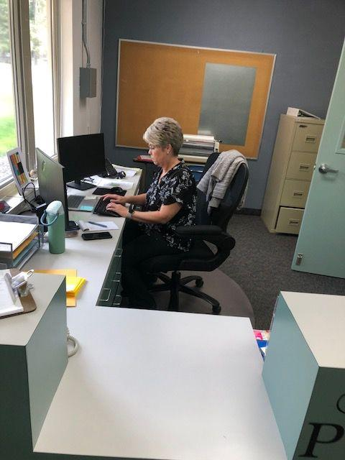
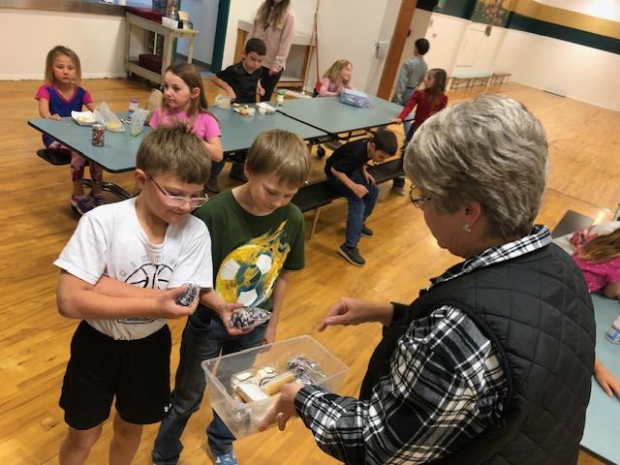
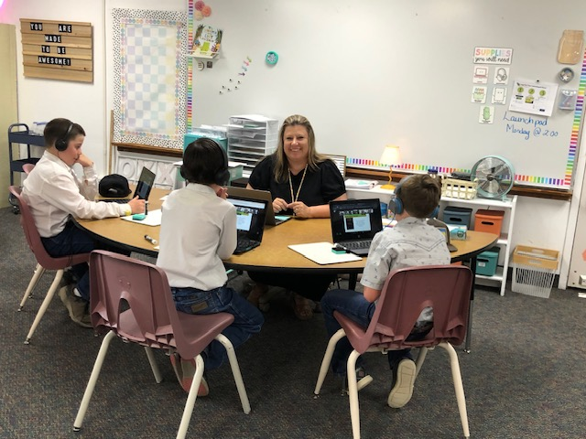
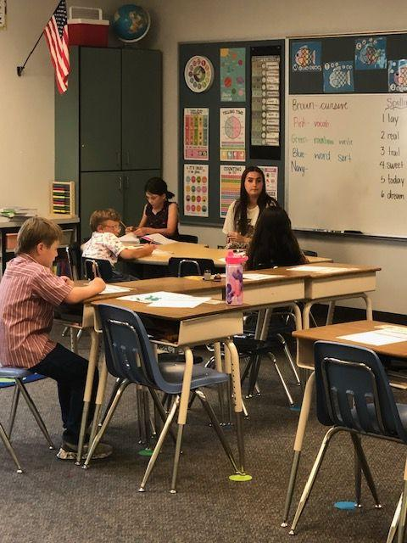
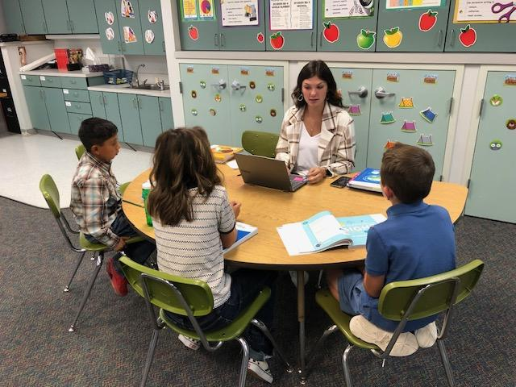
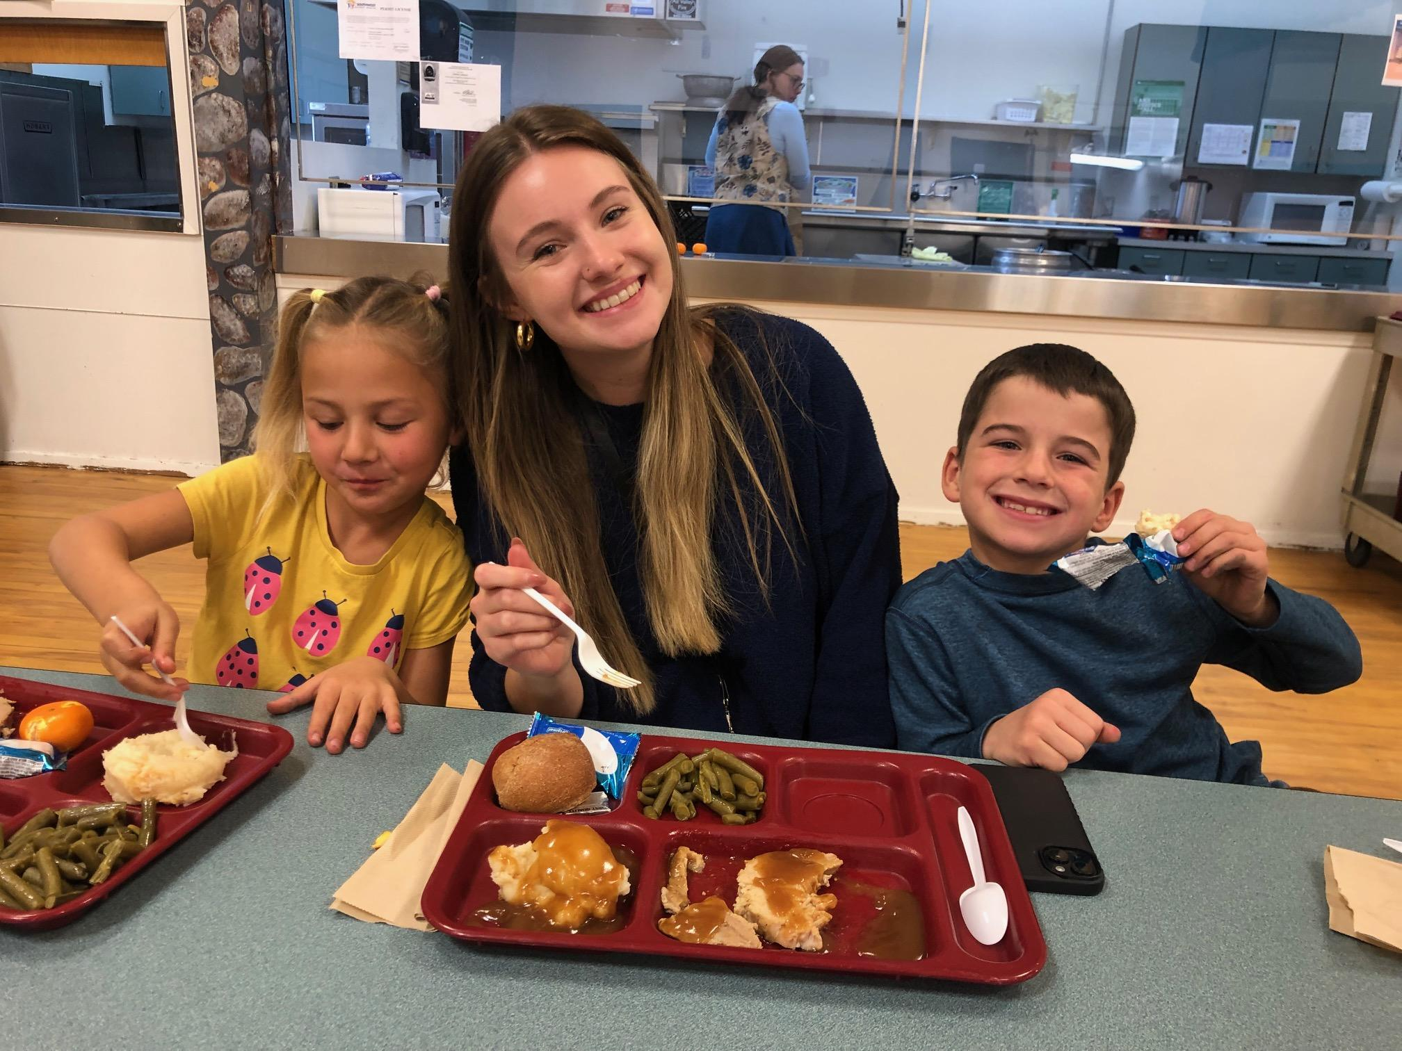
BES Staff Spotlight

Slide 23
Superintendent Report
Rimrock JR/SR High

Slide 24
Superintendent Report
Policy Committee Report
Monthly Finance Report
Operations Report

Slide 25
Series 8000 & 9000 - Reviewed in November
All available for Review on Share Drive
The 8000 and 9000 Series, along with 3380 were reviewed at the November board meeting.
They are ready for approval as listed in Action Items II in the Agenda.

Slide 26
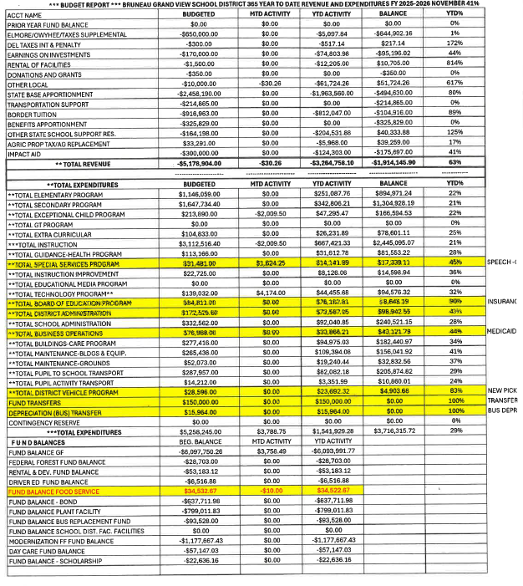
Monthly Financial Report – November 30
(Target goal for November 30 is 41% in the YTD Total Column for both Revenue and Expenditures)
REVENUES (Total Revenues for Sept. - 63%)
Rental of Facilities - Daycare - 814%
Other Local (617%) - Greenhouse Grant
State Based Apportionment - (80%) - Payment from the State (Front loaded payment)
Other State School Support (125%) - State Facilities Fund $ put here
EXPENDITURES (Total Expenses 29%)
Total Special Service Program - 45% (OT/Speech/SLP)
Total Board of Educ. Prog. (90%) - Annual Insurance Payment, Workmans Comp., Fees
Total District Admin - 43%
Total Business Operations - 44%
Total District Vehicle (83%) - New PU
FUND BALANCE
290-Food Service - $34,522.67

Slide 27
Operations - Business Manager Report
Fund Balance: Food Service - $34,522.67
    Students are not eating lunch (only 20% order lunch @RR)
    Personnel salaries remain the same regardless of # of students eating
Check Forgery and Fraud - $4,250.00
Bus Replacement -Thomas Bus
    Brad Carpenter, local bid on Source Well
    $154,649.00-Purchase Order 71378-$93, 528.00 Bus Fund the rest will come out of general fund-$61,121.00
    2026 after July, next year’s budget

Slide 28
Operations - Grounds-Maintenance Report
Completion of security fencing of the RR NW perimeter.
      Revised Plan - Daycare corral omitted. Add only one security gate between portables
Estimate received
    Boise River Fence - $15,080 (Revised Plan - $8,580)
    Anvil Fence - $18,176
    Meridian Fence - $20,722
Schedule installation - January and March

Slide 29
