Slide 1



February 10, 2026
1:00 PM Rimrock Library

Slide 2
January was School Board Recognition Month, and the Bruneau-Grand View Joint School District wants to take a moment to shine a spotlight on our dedicated Trustees.
Serving on a school board is a labor of love. It involves long hours, difficult decisions, and a true passion for our community’s youth. Our board members work tirelessly behind the scenes to guide our district, support our staff, and advocate for our students.
We would like to recognize the following individuals for their service:
JayDene Aquiso Board Clerk
Steven Boren Zone 5
Elaine Eldridge Zone 1
Raelynn Mathews Zone 3
Scott McNeley Zone 4
Allen Merrick Zone 2
To our Board Members: Thank you for your leadership, your time, and your commitment to making our district a great place to learn and grow. We appreciate everything you do!

Slide 3



Rimrock Principal Celebrations of Success

Slide 4
Rimrock Academics, Behavior & Culture
Academics:
No academic testing data for January
All Senior Papers complete!
Current Enrollment: 123 (net change = -1)
Attendance: Average Daily Attendance: 92% (for year) / 89% (for January) . . . Goal: 95%
Behavior: 14 BRtI Violations in Jan (~0.9 / day), but 17 already in Feb (3.4 / day)
Athletics:
HS Girls Basketball: Varsity = 13 - 11 overall (9-2 conference), play Compass next TONIGHT in District elimination game
HS Boys Basketball: Varsity = 16 - 2 overall (8-1 Conference), 2 games remaining then playoffs
JH Boys Basketball: 2-2
Employee Recognition: Amanda Dygert
Facilitated outstanding academic growth in MAP Language (67th / 69th percentile for grades 9 & 10) & Reading (69th / 57th percentile for grades 9 & 10)
Senior Class Advisor…mentors class through graduation planning process, planning senior trip, and senior projects
Head HS track coach this upcoming spring

Slide 5

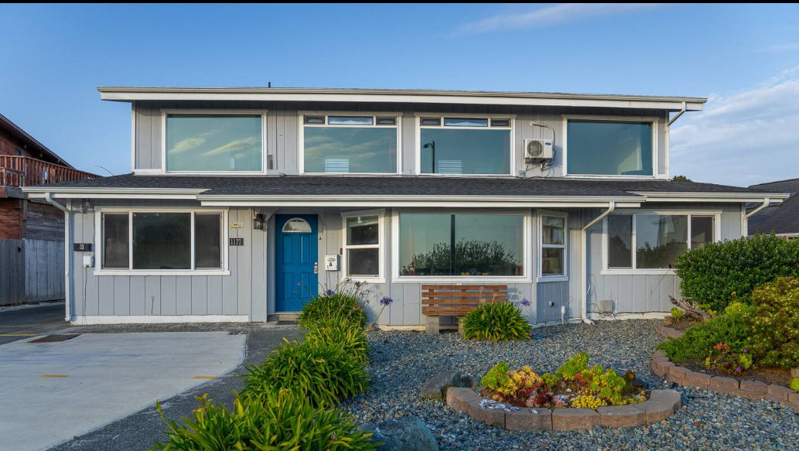
Senior Trip: Northern California, 20-24 Mar 26
(For Approval)
Chaperones: Amanda Dygert, Jonathan Waterlander
Transportation:Rimrock White Bus
Accomodations: 5 BR AirBnB in Crescent City
Itinerary:
Friday, March 20
Depart at 6:00 AM
Estimated arrival at 6:00 PM
Unpack
Go Shopping
Beach/dinner
Saturday, March 21 – Crescent City
Explore Crescent City
Harbor District
Battery Point Lighthouse
Point St. George Trail
Sunday, March 22 – South
Fern Canyon (Hiking)
Redwood National Park
Trees of Mystery
Monday, March 23 – North / Brookings
Brookings
Mill Beach
Restaurant dinner
Oregon Redwoods Trail
Tuesday, March 24
Depart at 6:00 AM
Estimated Return at: 7:00 PM
Optional Activities (Any Day, Weather-Dependent)
Fishing at Brookings
Spikeball
Kayak Rental
Cornhole

Slide 6
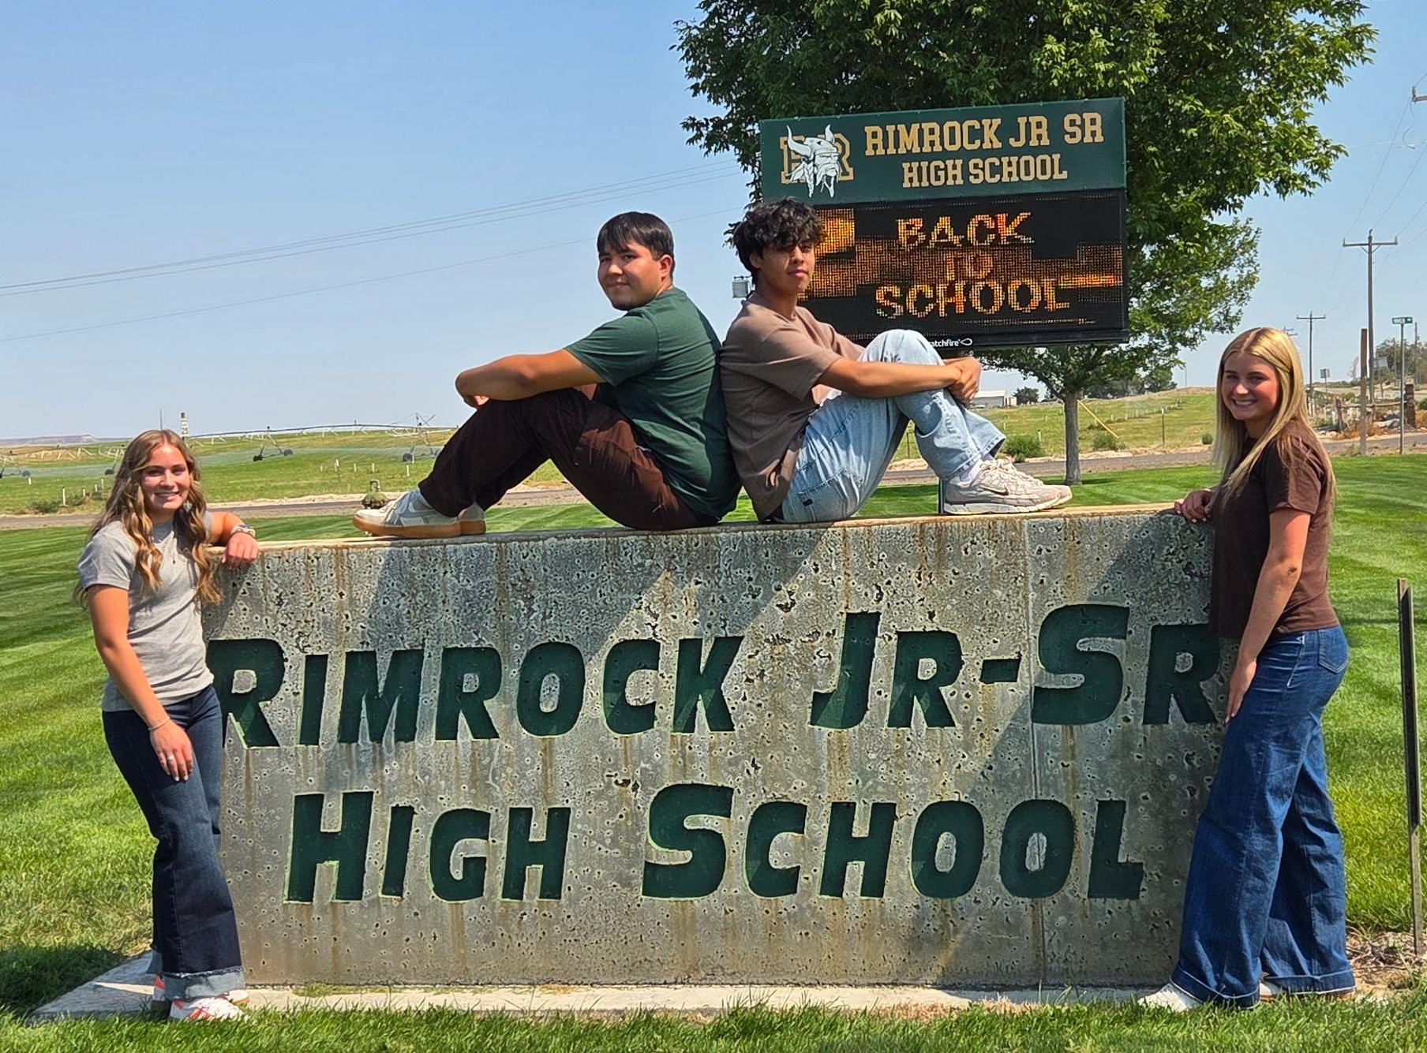
2025 - 2026
Rimrock Student Body Government
Bringing back spirit and fun to the students and staff at Rimrock
Celebrating student successes
Student of the Month and Student of the Quarter -
Homecoming week - including HOCO shirts, Macho Volleyball, Powderpuff Football, Homecoming Parade, Royalty Voting and Photos, Halftime Queen and King Crowning
Contests Held:
Door decorating
Hallway Decorating
Rimrock Coin Art contest
Monthly Spirit Assemblies:
Whole school and class competitions
Dress Up Weeks & Sports Home Game Dress up Themes
Upcoming:
Mental Health Awareness speaker and t-shirt campaign
Notes:
Introduce yourselves - Carlos, Gael, Lainee, Paisley and your role
Carlos - Our goals this year -
Gael - Main events planned so far this year - hit the points on the slide.
Paisley - Upcoming events - Mental Health Awareness speaker and T Shirt Campaign overview and the need we see for it. We are reaching out for ICCU to sponsor us for the T-Shirts. These assemblies cost lots of money that we have got from previous sponsors.

Slide 7
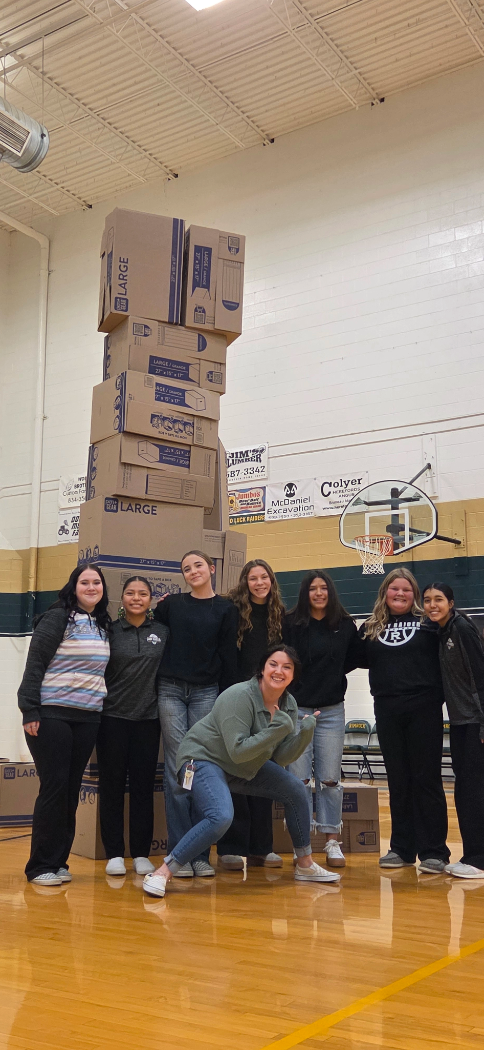
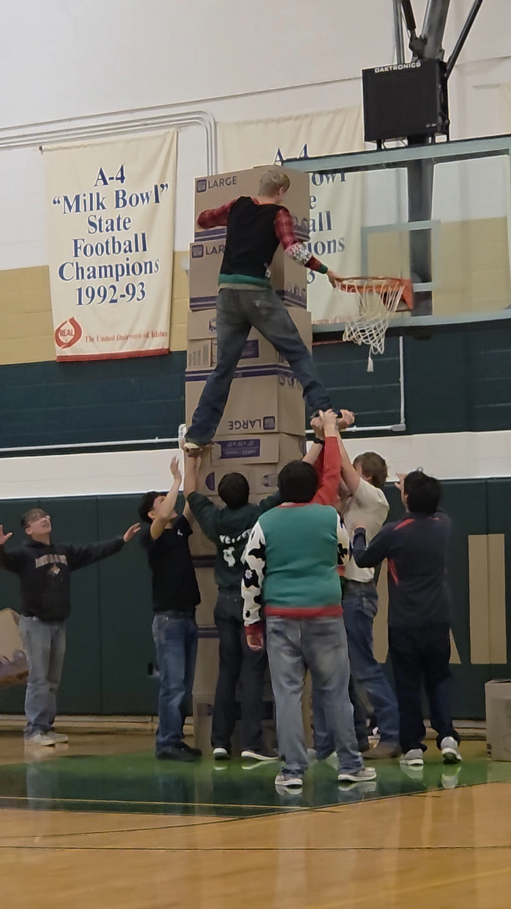
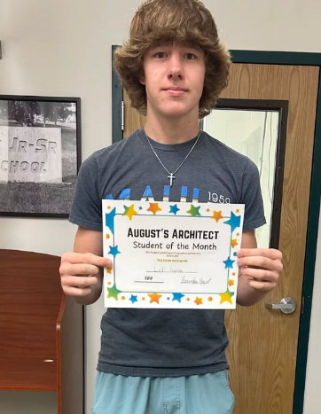
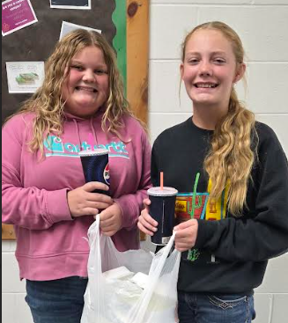
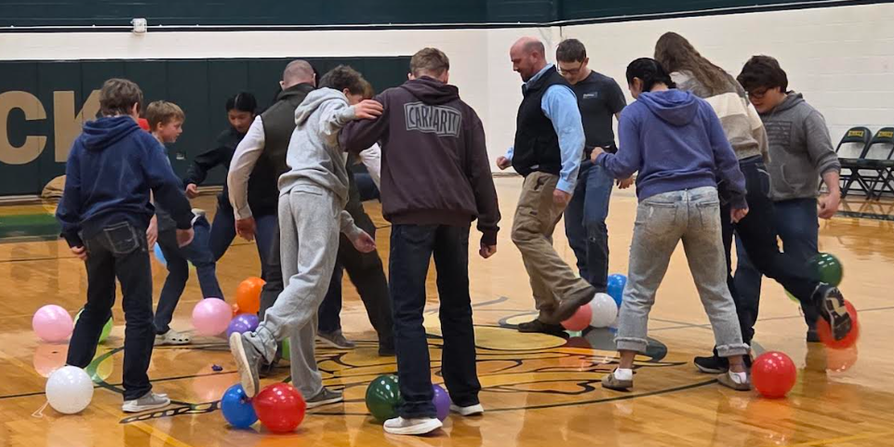
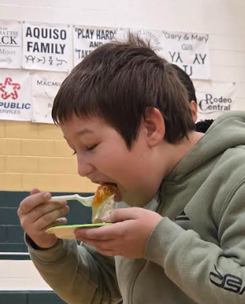
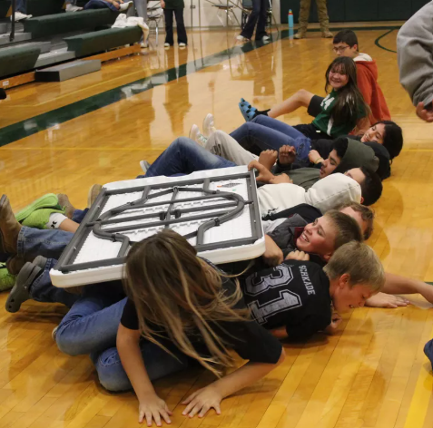
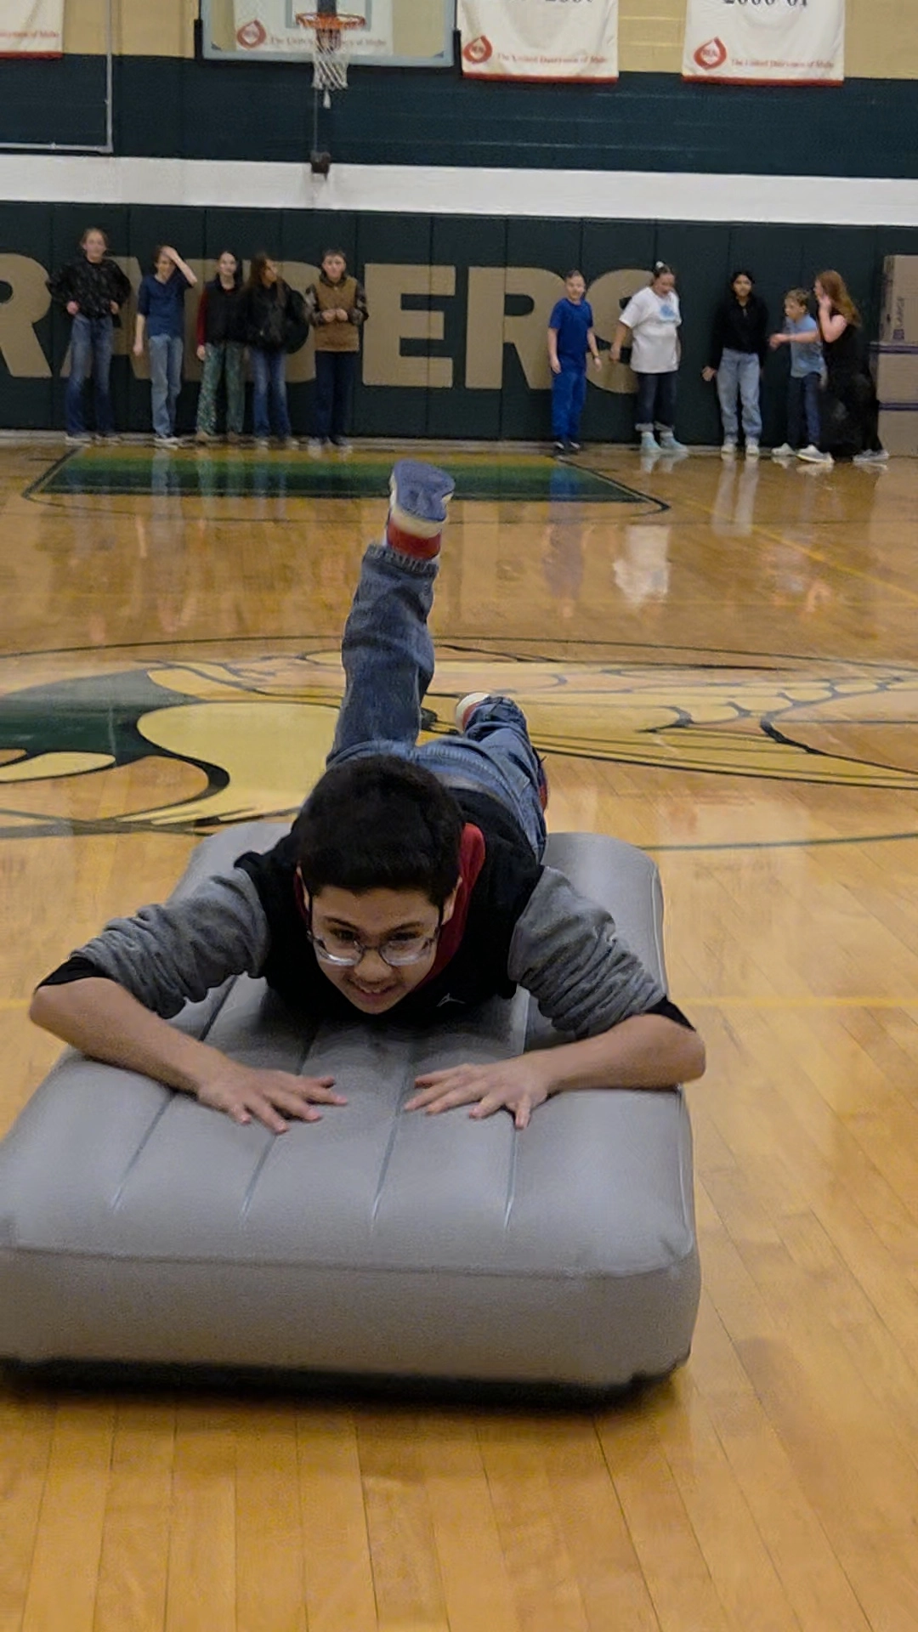
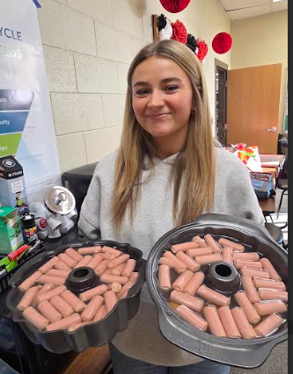
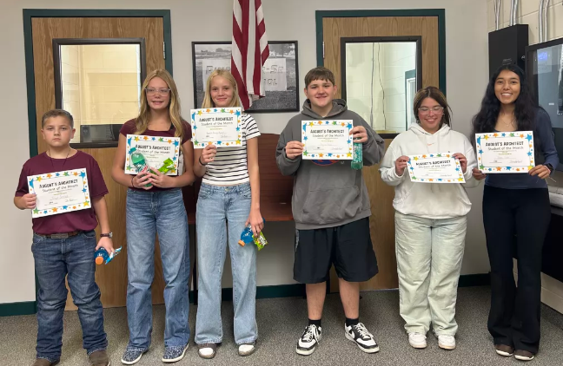
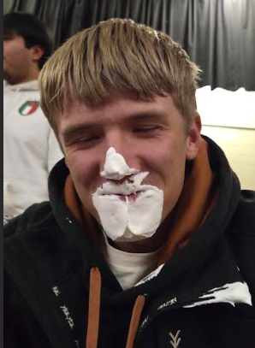
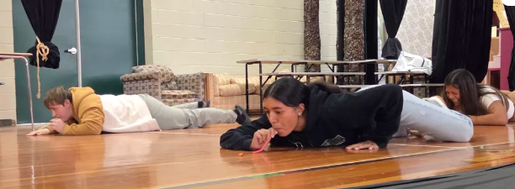
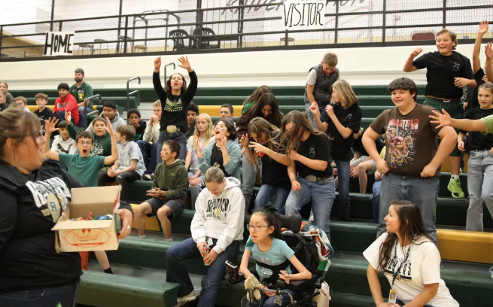
Monthly Activities
Student of the Month and Student of the Quarter -
Assemblies
Notes:
Lainee - Explain SOM and SOQ - then Assembly overview

Slide 8
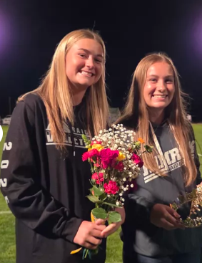
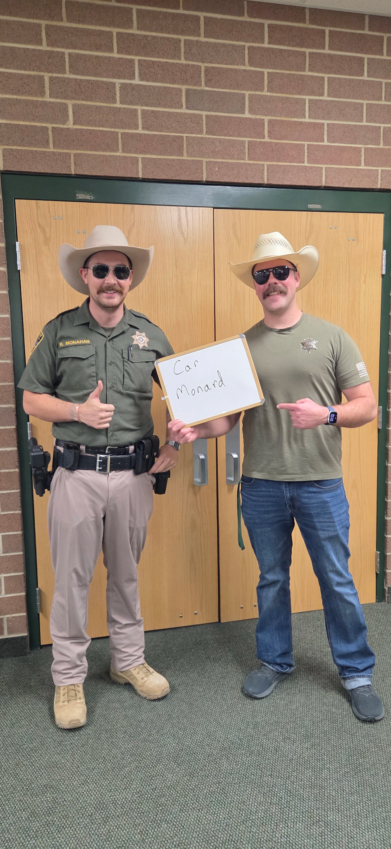
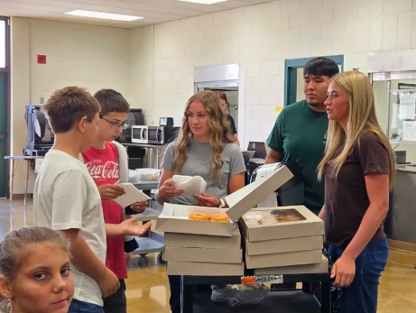
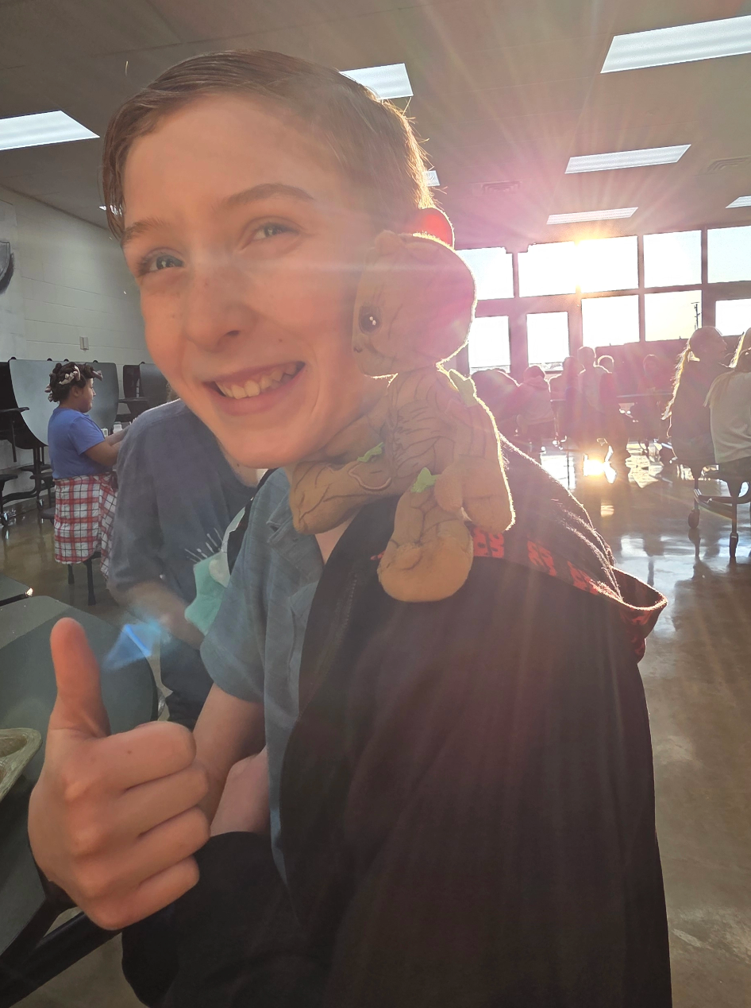
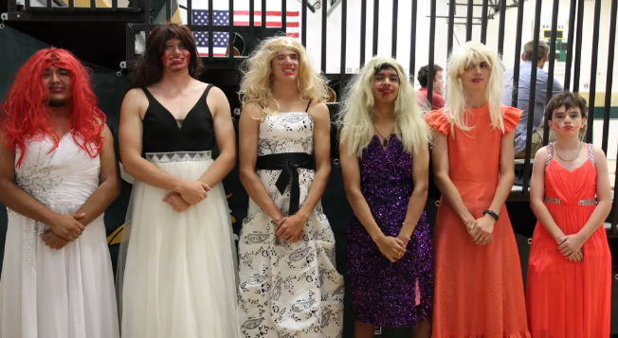
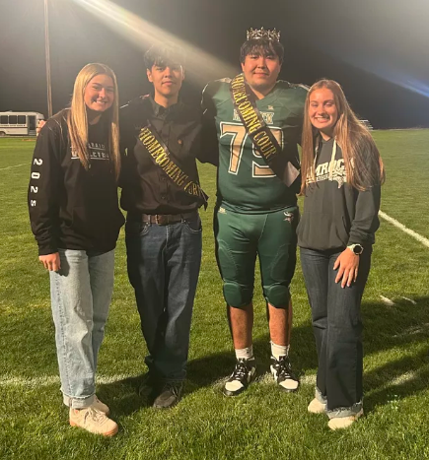
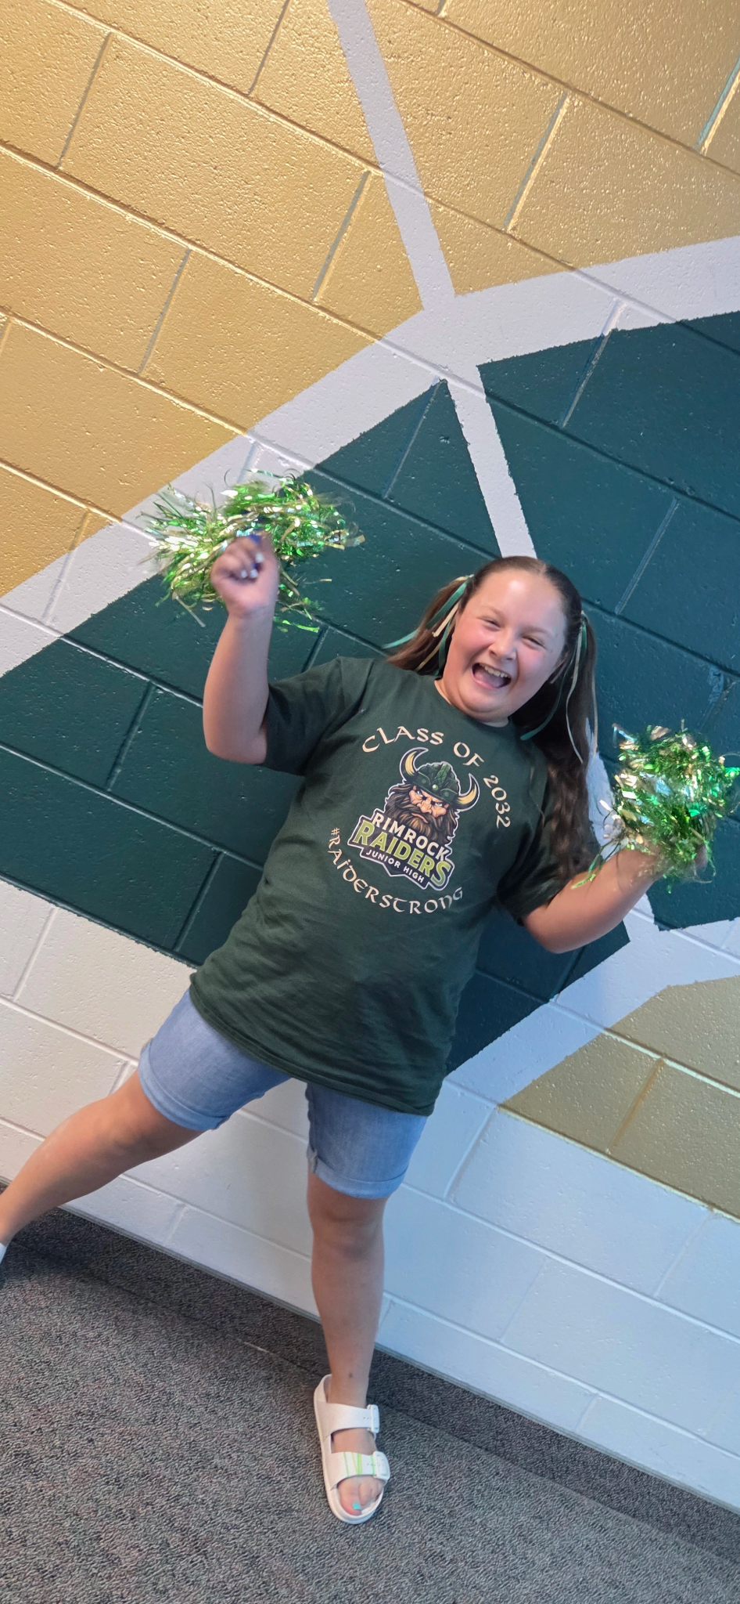
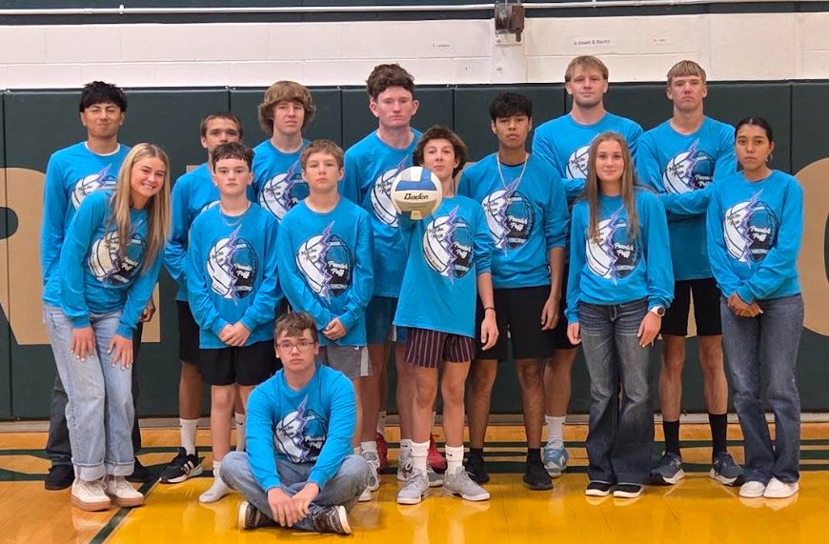
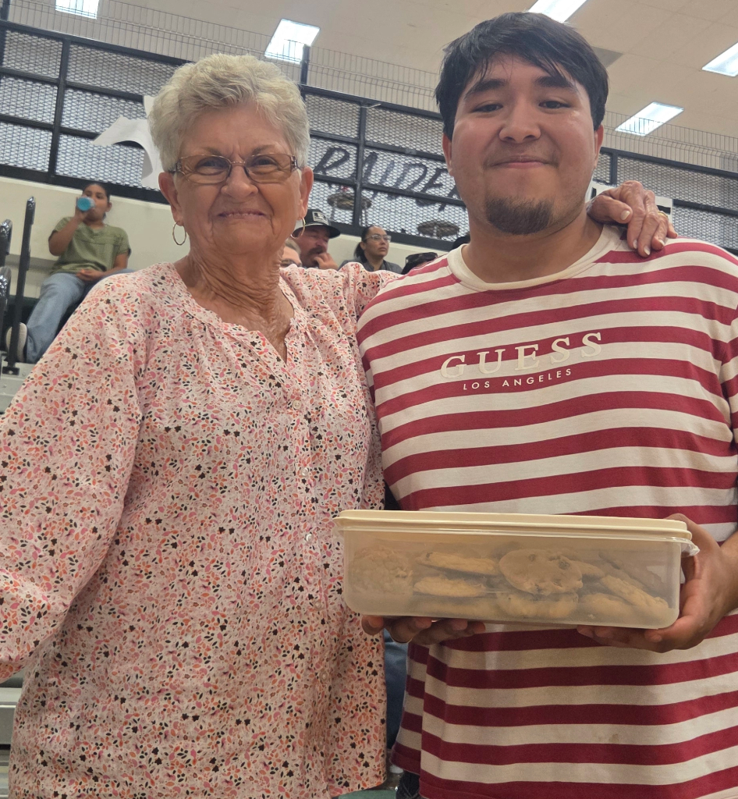
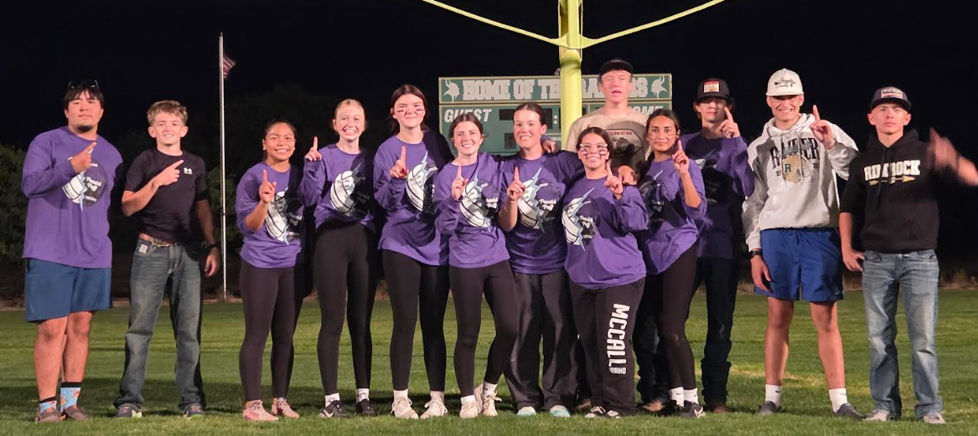
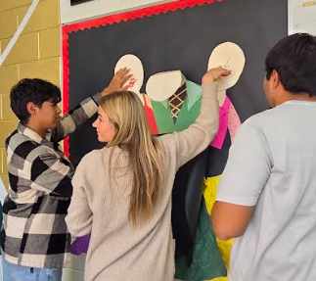
Dress Up Days
Homecoming
week
Back to School Donuts
&
Quarter Three Kick off Cookies
Monthly Bulletin Boards
Community Support and Appreciation
Notes:
Paisley - Explain Slide - Mention community support - Many staff, community and students have expressed appreciation for the events and spirit this year. We are also very grateful to our sponsors. We held three fundraisers, but also did a community appeal for financial support, and the support we have recieved is overwhelming and makes our activities possible.

Slide 9
Elementary Principals Celebrations of Success

Slide 10
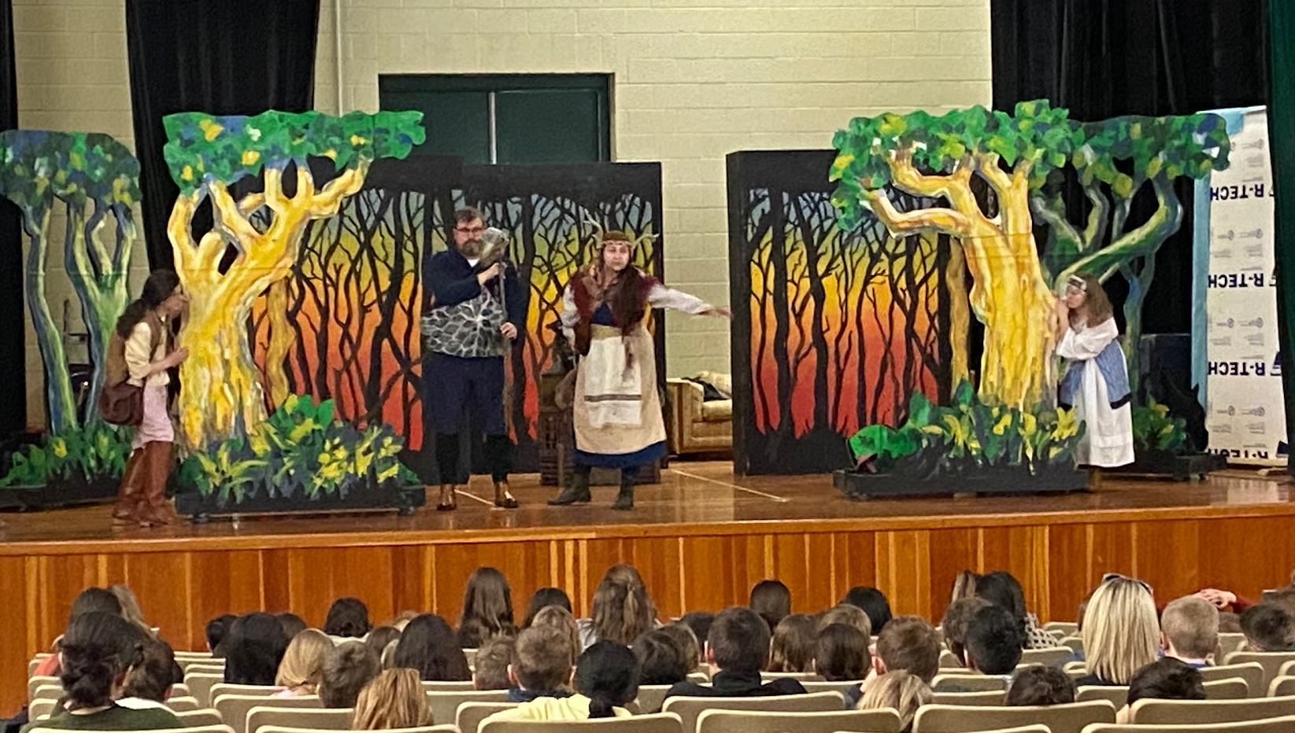
Idaho Theater for Youth Performance
The Keepers of the Wood

Slide 11
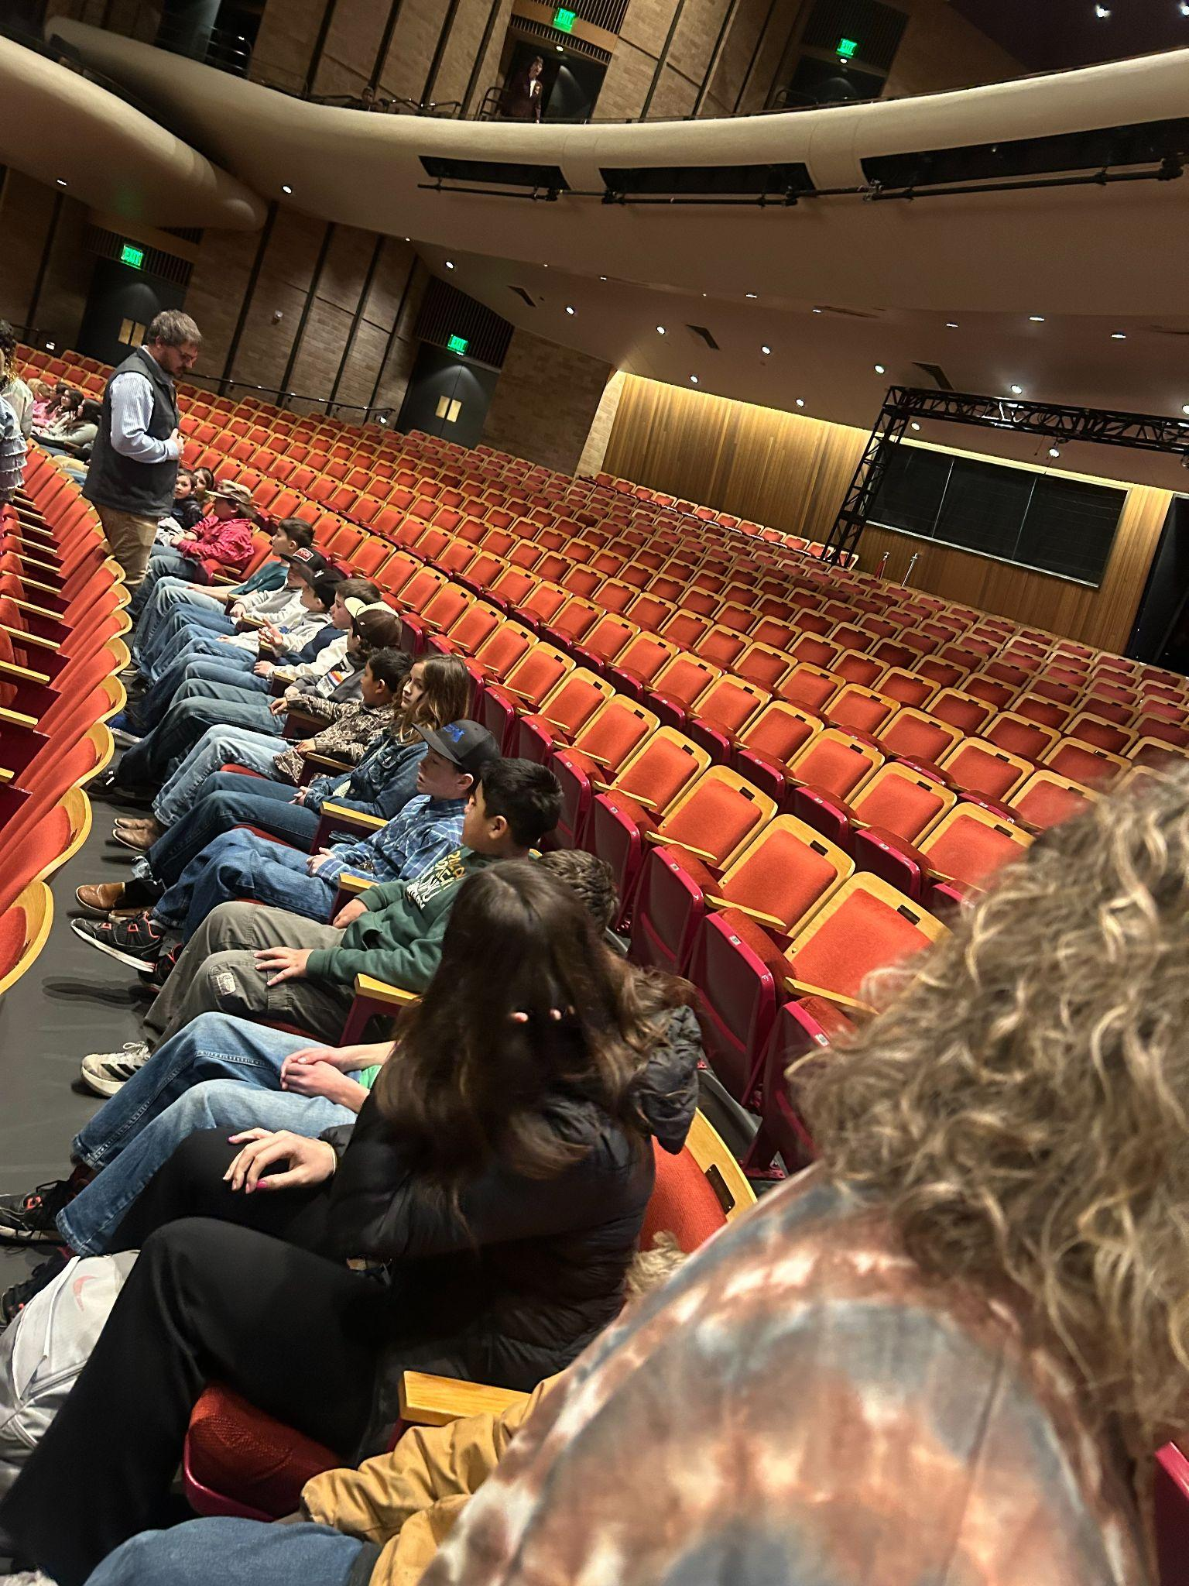
Boise Philharmonic
*West Side Story, “America” - Leonard Bernstein, arr. Jack Mason
*Symphony No. 9 in E minor, “From the New World”, Op. 95, Mvt. I: Adagio – Allegro molto - Antonin Dvorak (Transatlantic journey themes)
*Battalia à 10, Mvt. 2: Die liederliche Gesellschaf von allerley Humor - Heinrich Biber (“Melting Pot” through layered melodies)
*Chokfi’ - Jerod Impichchaachaaha’ Tate (Native American storytelling)
*Supermaximum - Kenji Bunch (Call and response in American tradition)
*American Salute - Morton Gould (American folk song)
*Stars and Stripes Forever - John Philip Sousa (Music for American solidarity)
*Children of Sanchez - Chuck Mangione (Jazz – the American genre)
*Star Wars: Main Theme - John Williams (Enduring American music)

Slide 12
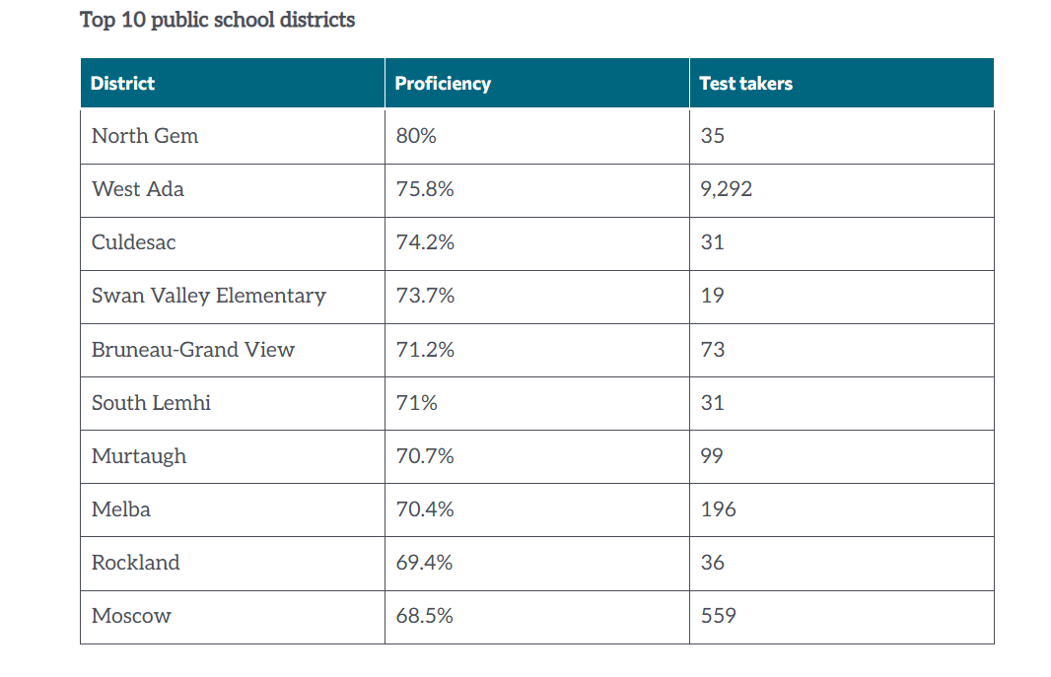
Featured
https://www.idahoednews.org/news/top-10-lists-see-who-fared-best-on-the-new-reading-test/

Slide 13

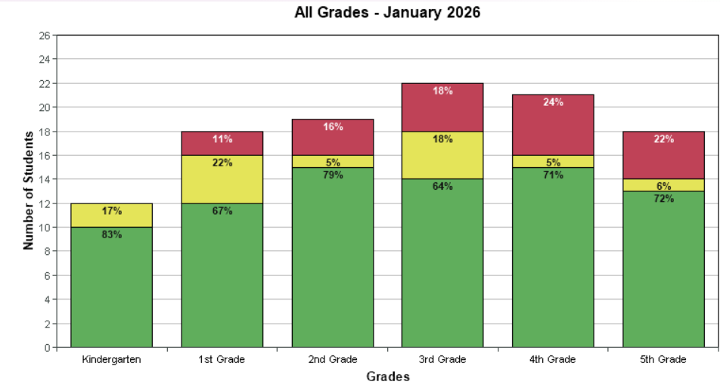

Slide 14
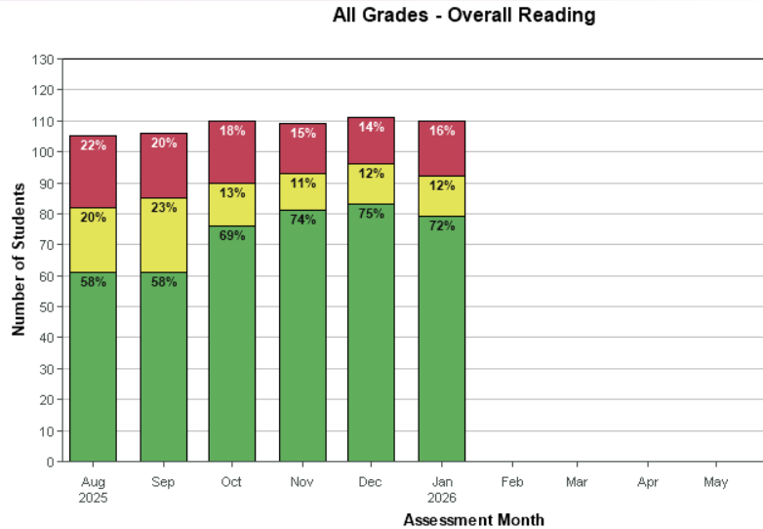

Slide 15
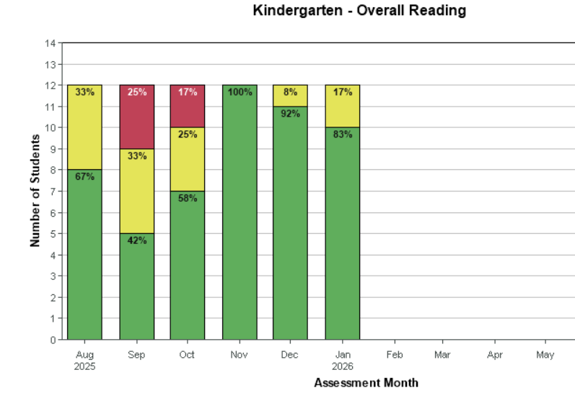

Slide 16
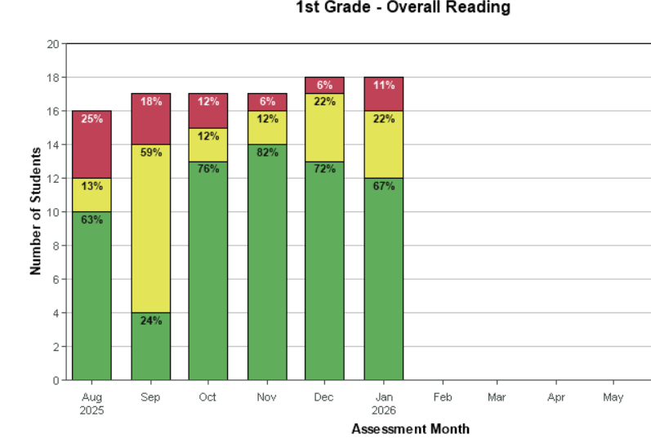

Slide 17
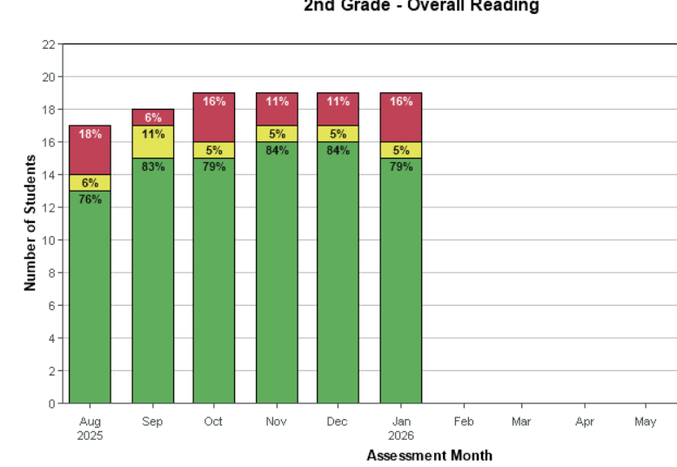

Slide 18
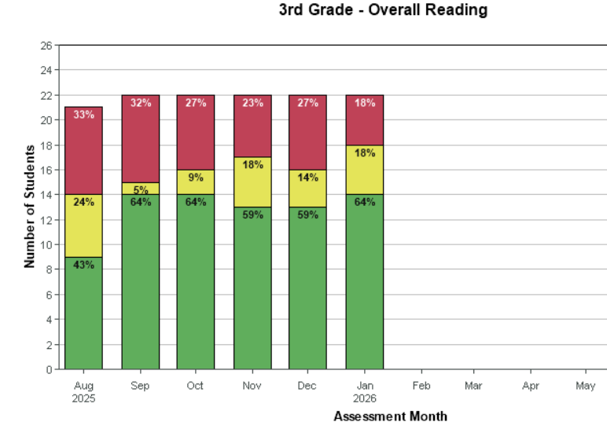

Slide 19
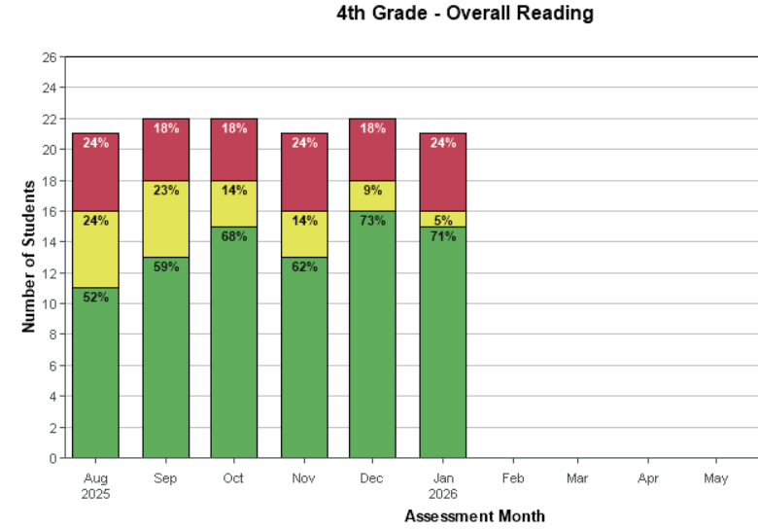

Slide 20
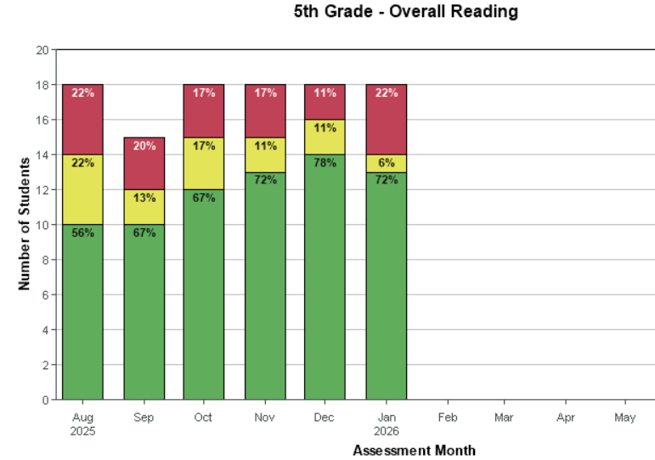

Slide 21

Annual Typical Growth
Students | 53 | 34 | 27
Descriptor | Likely | Somewhat Likely | Somewhat Unlikely
Breakdown | >70% probable | 50-70% probable | <50% probable
*grade level

Slide 22
Enrollment Update
GVE: 105 (No change this month) +17 PreK BES: 23

Slide 23
Upcoming Events
3/2-3/5:Read Across America Week
3/5:100th day of school
3/17: Student-Led Conferences and Raider Quests
3/23-3/26: Spring Break

Slide 24
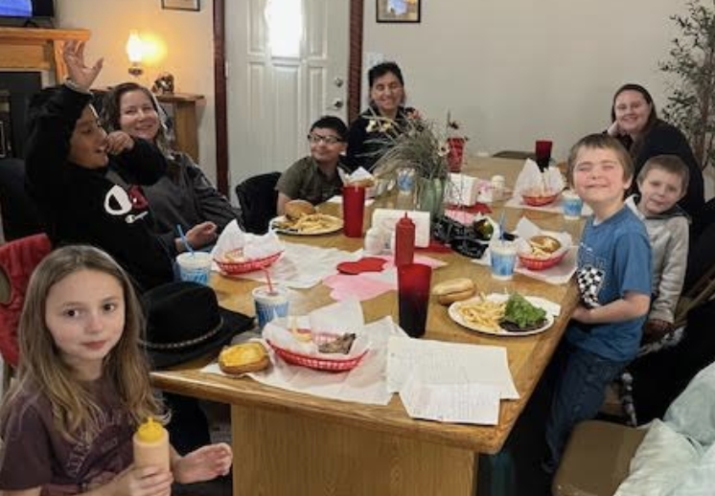
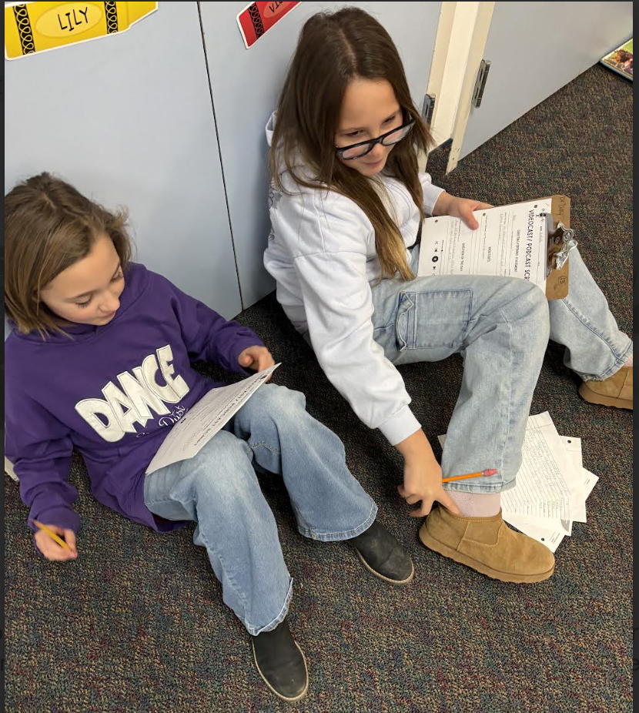
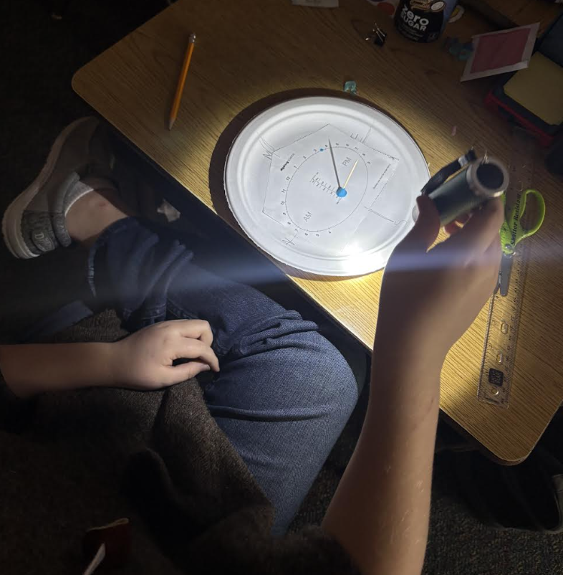
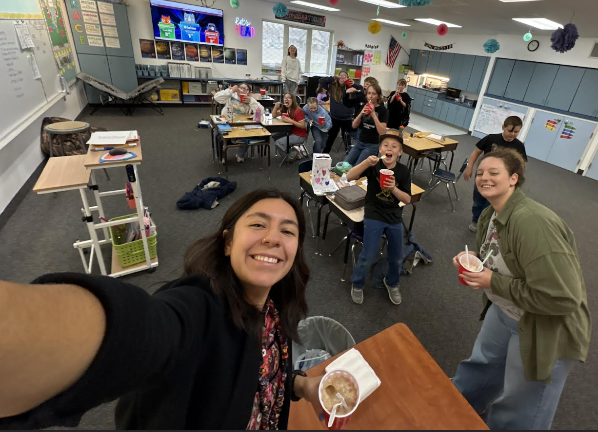
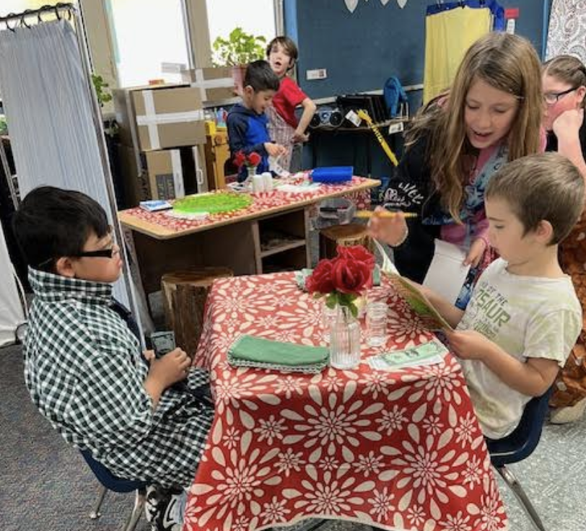
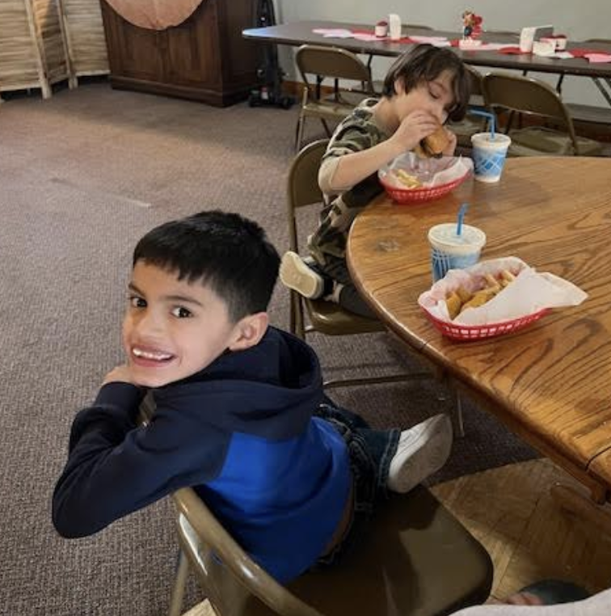
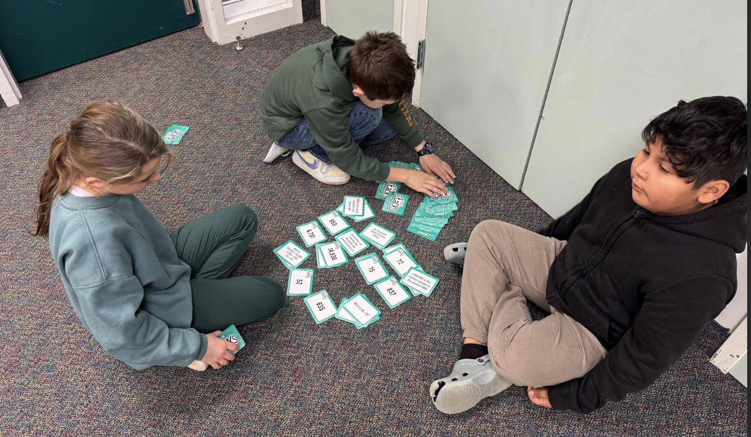
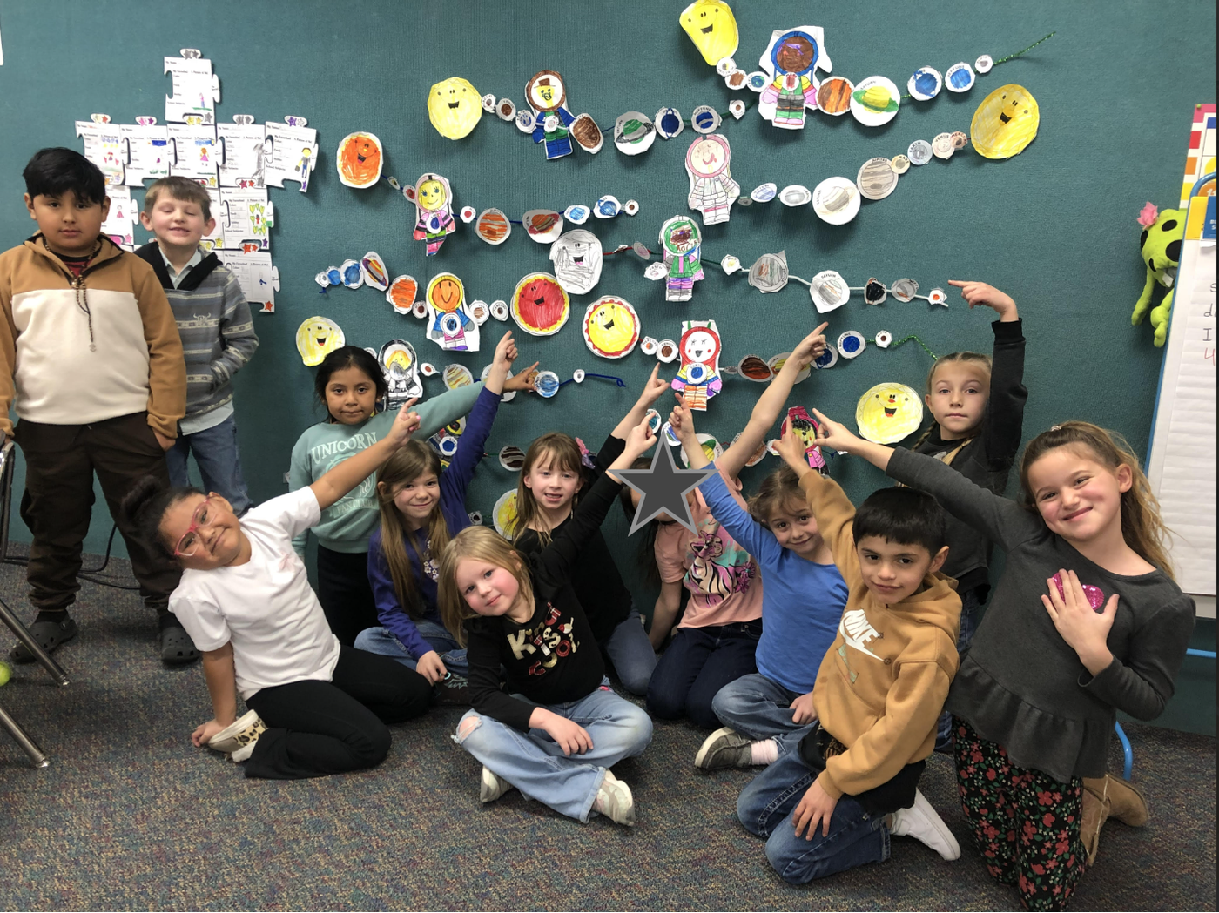
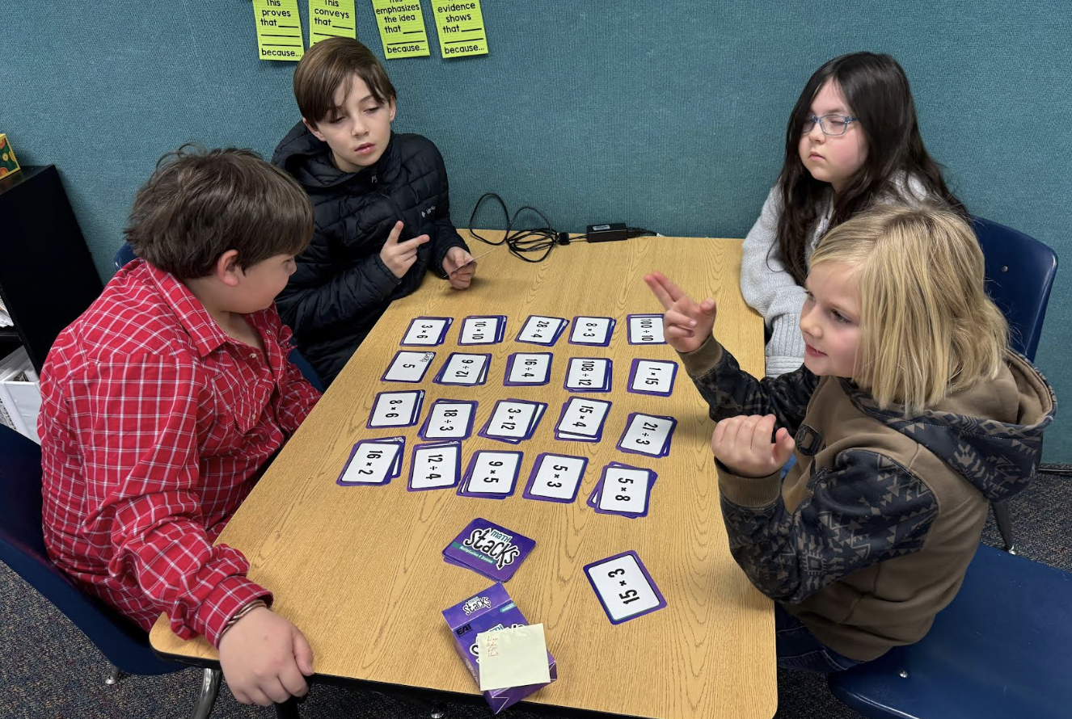
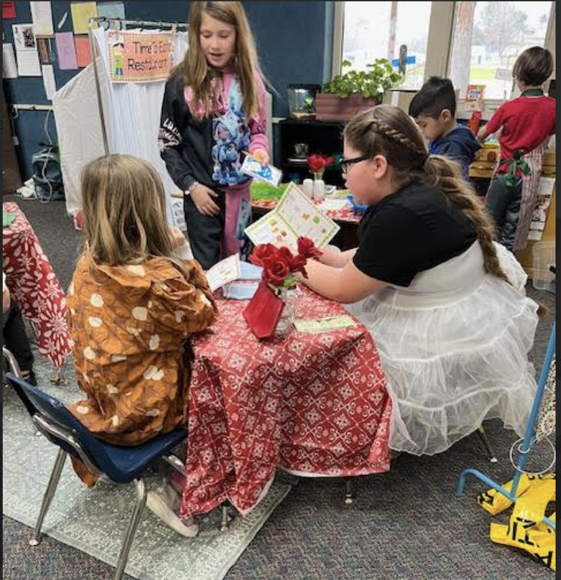
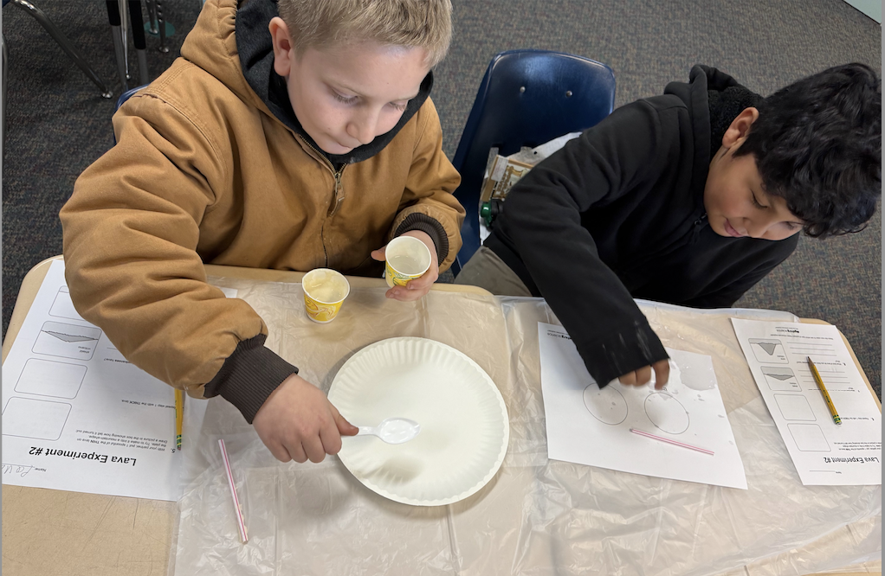
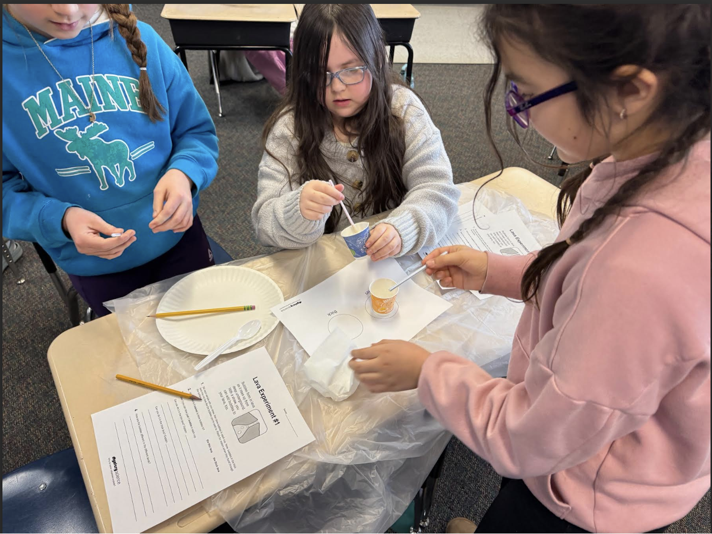
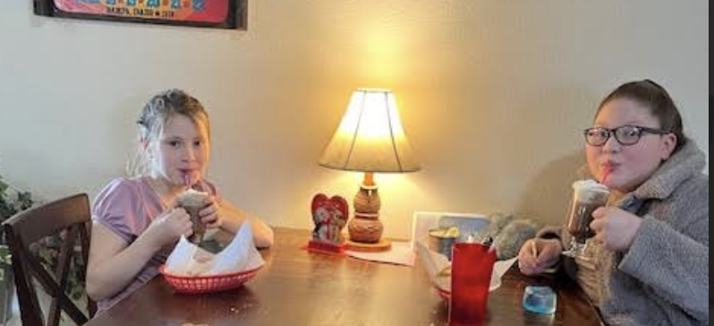








GVE

Slide 25
GVE Staff Spotlight - Susan Wampler
I have truly enjoyed teaching the students in the BGV School district for the past 24 years. It has been a privilege to watch the students grow and learn and be able to teach their children as well.
I was born and raised on a farm in Caldwell, ID. With both of my parents being teachers, I grew up feeling that was the job that I wanted to do most. I received my bachelor's from Idaho State University in Early Childhood and Elementary Education and my masters in literacy from Boise State University. When I am not teaching, I can be found traveling, spending time gardening, or reading a good book.

Slide 26





BES

Slide 27
Bruneau Elementary School
We are thrilled to recognize Summer Virnig, our 2nd/3rd Grade Teacher at Bruneau Elementary, as this month's Teacher of the Month!
Ms. Virnig joined the Bruneau-Grand View Joint School District in the fall of 2025, bringing with her a deep dedication to student success. Before stepping into her current classroom, she gained valuable experience as a Special Education Paraprofessional at Kimberly Elementary School. She holds a Bachelor of Arts in Elementary Education from Western Governors University and is known for her skill in fostering student engagement through both group and individual instruction.
Her teaching philosophy is driven by her two biggest passions: working with children and exploring nature. She strives to bring that sense of discovery into her classroom every day.

Slide 28






Bruneau Elementary School
Students of the Month
Aden Eldridge Roan Folkman Ian Black

Slide 29







Interim Superintendent Update
Rimrock JR/SR High

Slide 30
Interim Superintendent Update
Professional Development:
iReady PD Report
January 16th PD Report
Leadership Update
John Wooden on Leadership
Lunch Program

Slide 31
Personnel
Letters of Intent: Sent out January 26th
Return February 5th
Advertise for Math Teacher at Rimrock-Active
Advertise HS Science
Advertise JH Science

Slide 32
Community Meetings
Oreana Hall: February 9th
Oreana Hall: February 13th-Attending the Valentines Dinner
Bruneau Elementary: March 9th
Grand View Elementary School: March 4th

Slide 33

Monthly Financial Report – January 31
(Target goal for January 31 is 59% in the YTD Total Column for both Revenue and Expenditures)
REVENUES (Total Revenues for Jan. - 72%)
Rental of Facilities - Daycare - 814%
Other Local (678%) - Greenhouse Grant
State Based Apportionment - (80%) - Payment from the State (Front loaded payment)
Other State School Support (142%) - State Facilities Fund $ put here
EXPENDITURES (Total Expenses 41%)
Total Special Service Program - 60% (OT/Speech/SLP)
Total Board of Educ. Prog. (95%) - Annual Insurance Payment, Workmans Comp., Fees
Total District Admin - 62%
Total Business Operations - 62%
Total District Vehicle (85%) - New PU
FUND BALANCE
290-Food Service - $41,984.57

Slide 34
Operations - Business Manager Report
Fund Balance: Food Service - $41,984.57
Check Forgery and Fraud - $7,230-money has came back to our account-JayDene is training on positive pay

